Slide 1
Correction for Electron “Protoemission“
Model, ideas, approaches, results

Slide 2
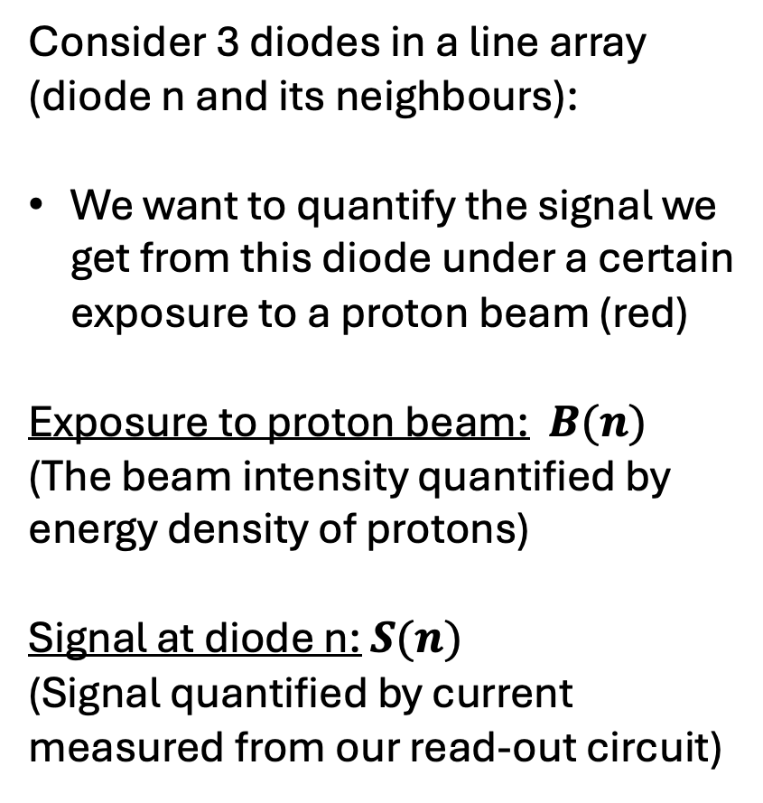
Model
Consider 3 diodes in a line array (diode n and its neighbours):
We want to quantify the signal we get from this diode under a certain exposure to a proton beam (red)
Exposure to proton beam: $B(n)$
(The beam intensity quantified by energy density of protons)
Signal at diode n: $S(n)$
(Signal quantified by current measured from our read-out circuit)
Diode n+1
Diode n
Diode n-1

Slide 3
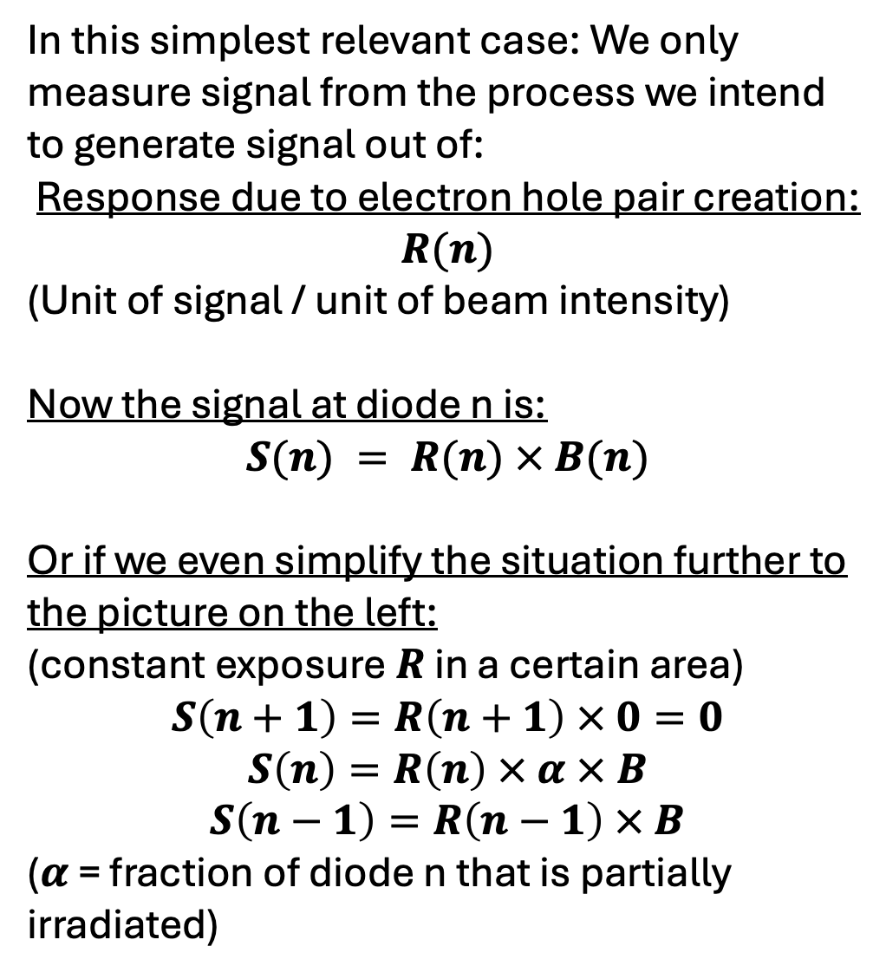
1. Naive case
In this simplest relevant case: We only measure signal from the process we intend to generate signal out of:
Response due to electron hole pair creation: $R(n)$
(Unit of signal / unit of beam intensity)
Now the signal at diode n is:
$$S(n) = R(n) × B(n)$$
Or if we even simplify the situation further to the picture on the left:
(constant exposure $R$ in a certain area)
$$S\left(n+1\right)=R\left(n+1\right) × 0=0$$
$$S\left(n\right)=R\left(n\right) × α × B$$
$$S\left(n−1\right)=R\left(n−1\right) × B$$
($α$ = fraction of diode n that is partially irradiated)
Diode n+1
Diode n
Diode n-1

Slide 4
This case is not what we observe though!
red = beam on
real shape
what we should see
what we see

Slide 5
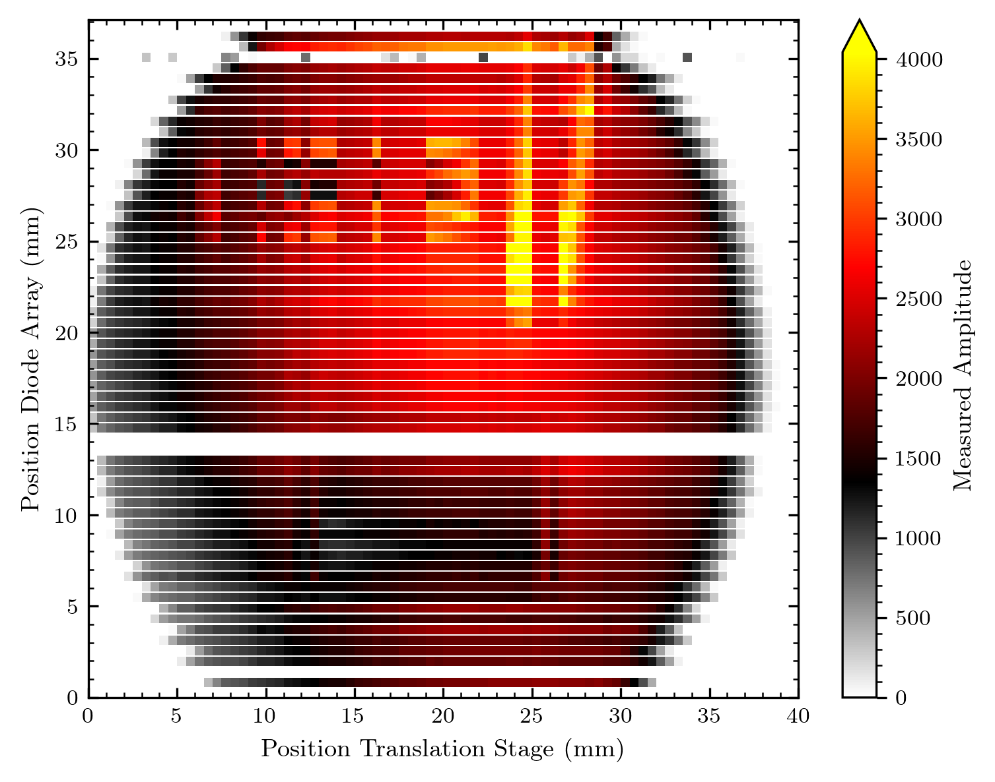
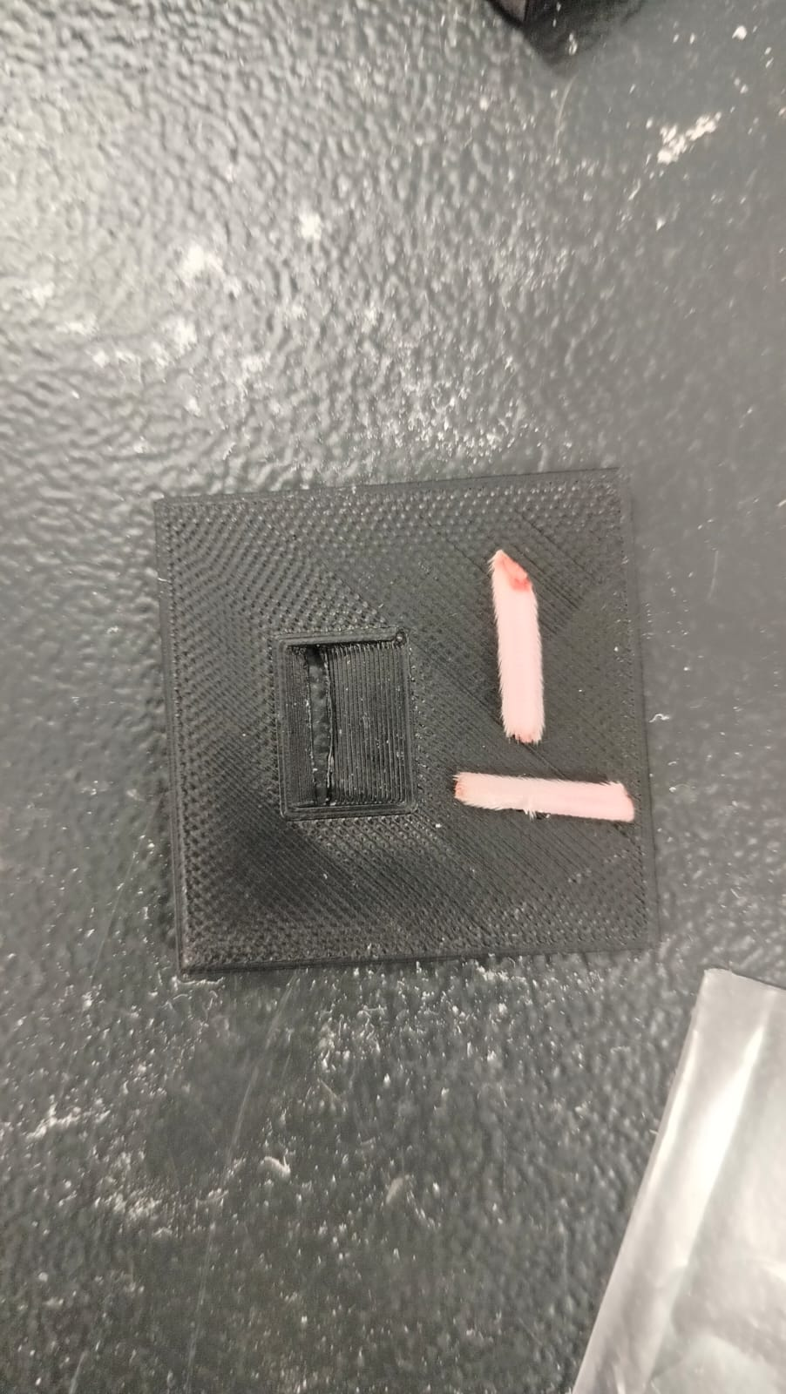
Example
But we do not see this step-like sampled shape of the round aperture
We observe a periodic modulation of shorter and longer lines…
longer
shorter
Object
round opening of
proton beam

Slide 6
2. Considering electron “protoemission“
Protons deposit energy in the GaN diode, especially in the i-GaN layer, where we detect this energy as a current from separated electron hole pairs.
But the protons also lose energy while passing through layers on top of the diode – for example the metal contacts.
Energy deposited here will mainly excite electrons, which can leave the metal when overcoming the necessary work function.
Electrons that leave the metal are a loss in our signal because we detect an electron current.

Slide 7
2. Some questions about this “protoemission“
Have I summarized the process correctly?
What is the exact transfer process for the electrons? (e.g. are they moved through air? Would a change of medium around the diode array change the transfer efficiency?)
Do we consider only the metal parts, probably mainly the MESA and/or the fan-out wiring to be responsible?
Are all electrons captured and detected by neighbour diodes?
Can we quantify this protoemission by measurements (and/or simulations) to have a proof for our model?

Slide 8
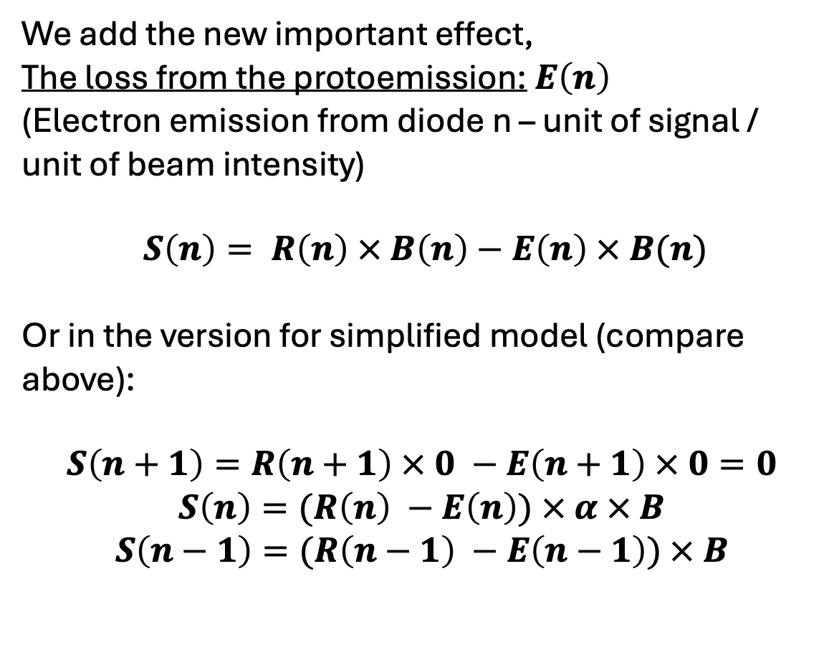
2. Model for protoemission
We add the new important effect,
The loss from the protoemission: $E\left(n\right)$
(Electron emission from diode n – unit of signal / unit of beam intensity)
$S\left(n\right)= R\left(n\right) × B\left(n\right)−E\left(n\right) × B(n)$
Or in the version for simplified model (compare above):
$$S\left(n+1\right)=R\left(n+1\right) × 0 −E\left(n+1\right) × 0=0$$
$$S\left(n\right)=(R\left(n\right) −E\left(n\right)) × α × B$$
$$S\left(n−1\right)=(R\left(n−1\right) −E\left(n−1\right)) × B$$

Slide 9
So far this is just the case from above with a signal decrease!

Slide 10
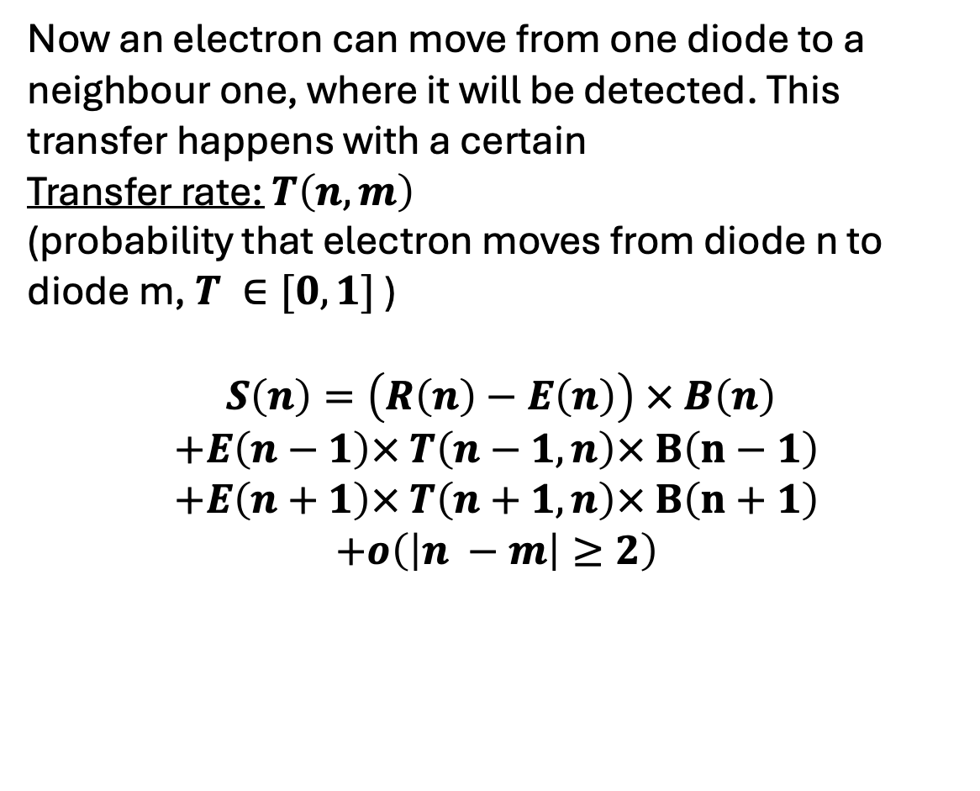
3. Consider electron transfer between diodes
Now an electron can move from one diode to a neighbour one, where it will be detected. This transfer happens with a certain
Transfer rate: $T\left(n, m\right)$
(probability that electron moves from diode n to diode m, $T ∈[0, 1]$ )
$S\left(n\right)=\left(R\left(n\right)−E\left(n\right)\right) × B\left(n\right)$
$$+E\left(n−1\right)× T\left(n−1, n\right)× B\left(n−1\right)$$
$$+E\left(n+1\right)× T\left(n+1, n\right)× B\left(n+1\right)$$
$$+o\left(\left|n −m\right|≥2\right)$$

Slide 11
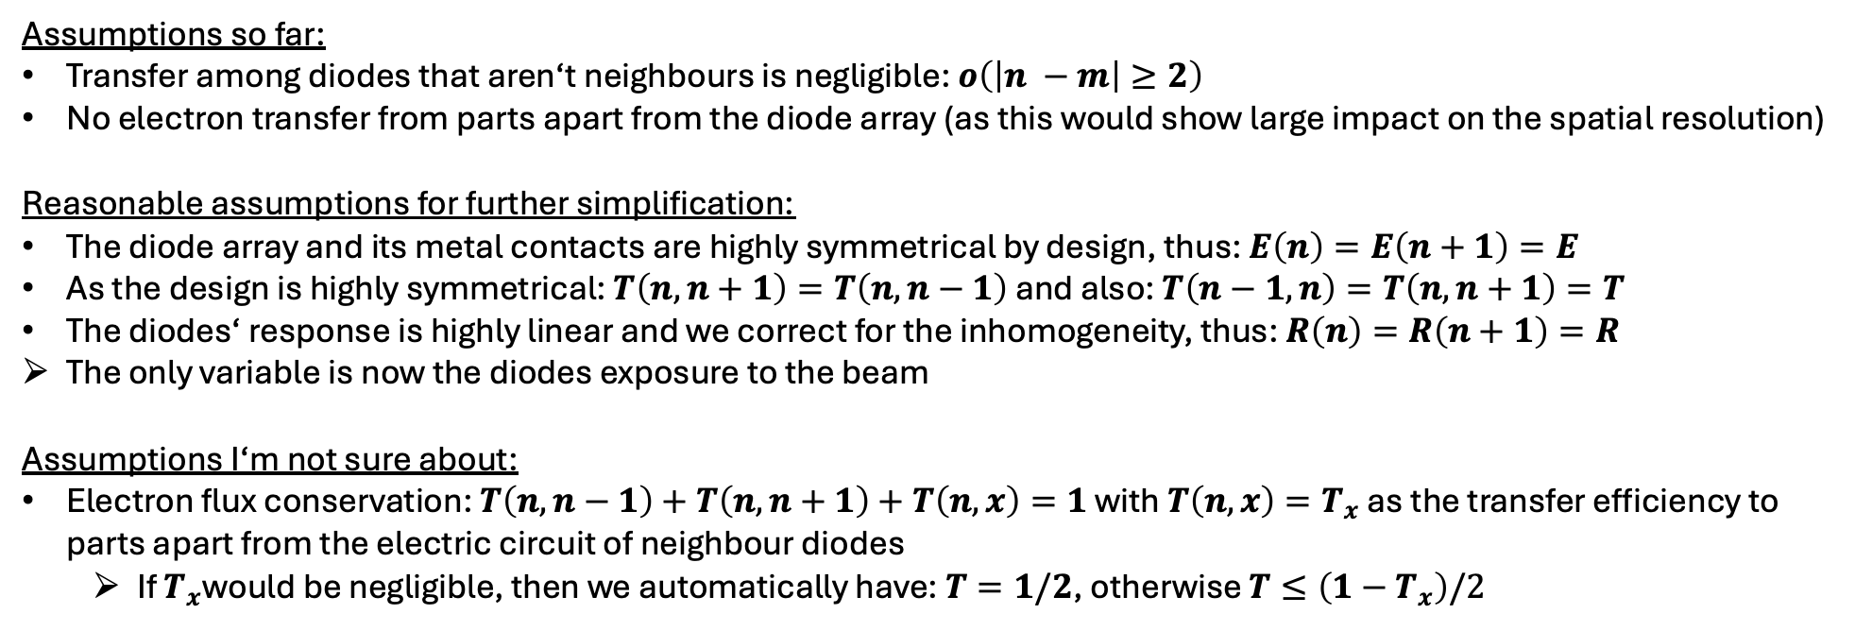
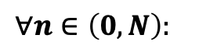
Final equation and assumptions
We look at a 1D diode array of length N, with 0 naming the first and N the last diode, then we model the signal by:
$$∀n∈\left(0, N\right):$$
$$S\left(n\right)=\left(R\left(n\right)−E\left(n\right)\right) × B\left(n\right)+E\left(n−1\right)× T\left(n−1, n\right)× B\left(n−1\right)+E\left(n+1\right)× T\left(n+1, n\right)× B\left(n+1\right)$$
e⁻-h⁺ creation
e⁻ received from neighbour diodes
(to ease the understanding we denote: n-1 below diode n, n+1 above)
proto-emission at diode n
Assumptions so far:
Transfer among diodes that aren‘t neighbours is negligible: $o\left(\left|n −m\right|≥2\right)$
No electron transfer from parts apart from the diode array (as this would show large impact on the spatial resolution)
Reasonable assumptions for further simplification:
The diode array and its metal contacts are highly symmetrical by design, thus: $E\left(n\right)=E\left(n+1\right)=E$
As the design is highly symmetrical: $T\left(n, n+1\right)=T\left(n, n−1\right)$ and also: $T\left(n−1, n\right)=T\left(n, n+1\right)=T$
The diodes‘ response is highly linear and we correct for the inhomogeneity, thus: $R\left(n\right)=R\left(n+1\right)=R$
The only variable is now the diodes exposure to the beam
Assumptions I‘m not sure about:
Electron flux conservation: $T\left(n, n−1\right)+T\left(n, n+1\right)+T\left(n, x\right)=1$ with $T\left(n, x\right)=T_{x}$ as the transfer efficiency to parts apart from the electric circuit of neighbour diodes
If $T_{x}$would be negligible, then we automatically have: $T=1/2$, otherwise $T≤\left(1−T_{x}\right)/2$

Slide 12
Apply model to situation of uniform beam
This was not 100% the case in the measurements (compare y-shift of diode array) but is reasonable enough and/or can be corrected because we have info about the y-characteristics of the beam

Slide 13
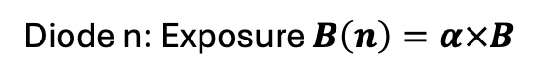
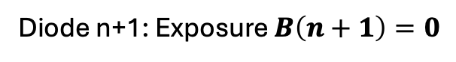
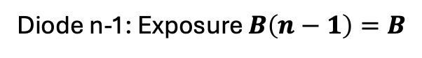
What the uniform beam changes
Red region, proton beam, equals exposure $B=const.$
Diode n+1: Exposure $B\left(n+1\right)=0$
Diode n: Exposure $B\left(n\right)=α×B$
Diode n-1: Exposure $B\left(n−1\right)=B$

Slide 14
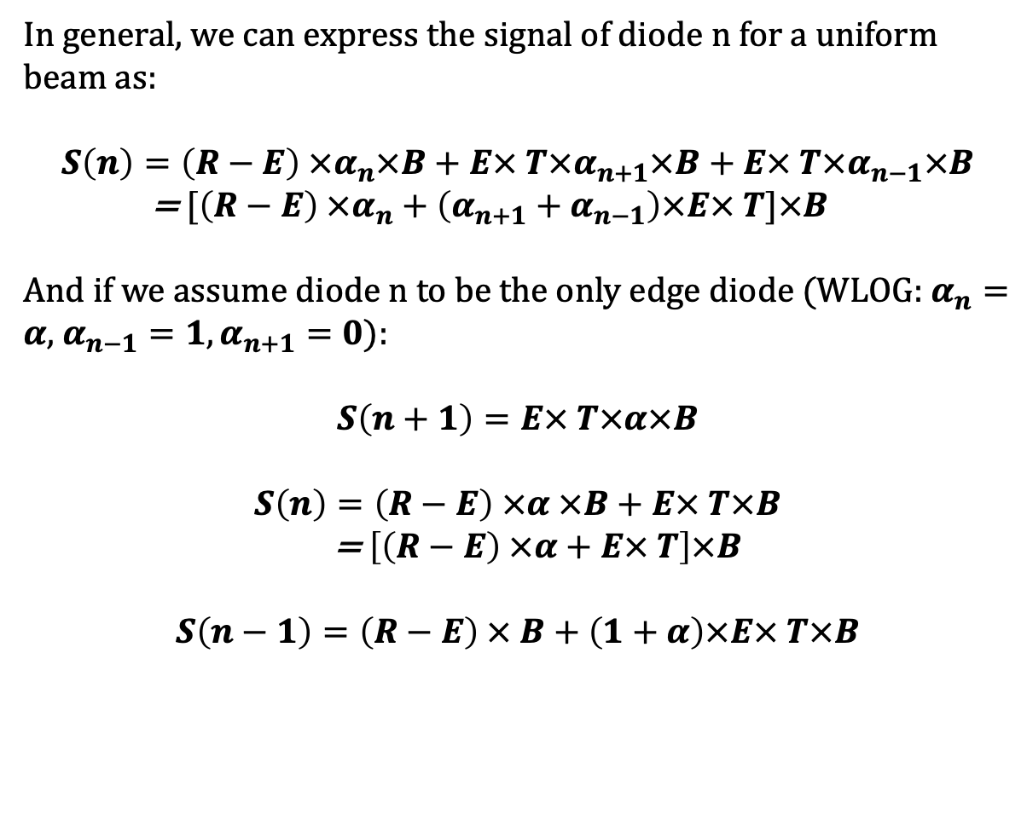
The equation in the uniform beam situation
In general, we can express the signal of diode n for a uniform beam as:
$$S\left(n\right)=\left(R−E\right) ×α_{n}×B+E× T×α_{n+1}×B+E× T×α_{n−1}×B$$
= $[\left(R−E\right) ×α_{n}+\left(α_{n+1}+α_{n−1}\right)×E× T]×B$
And if we assume diode n to be the only edge diode (WLOG: $α_{n}=α$, $α_{n−1}=1,α_{n+1}=0$):
$$S\left(n+1\right)=E× T×α×B$$
$$S\left(n\right)=\left(R−E\right) ×α ×B+E× T×B$$
= $\left[\left(R−E\right) ×α+E× T\right]×B$
$$S\left(n−1\right)=\left(R−E\right) × B+\left(1+α\right)×E× T×B$$
Diode n+1
Diode n
Diode n-1

Slide 15
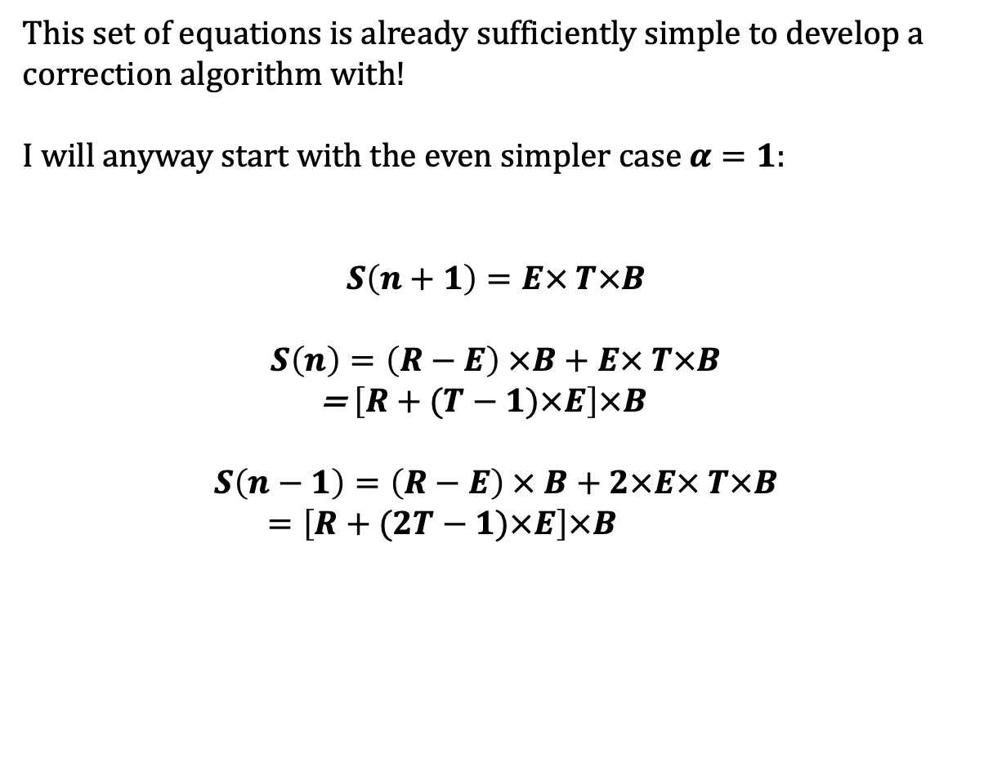
The equation in the uniform beam situation
This set of equations is already sufficiently simple to develop a correction algorithm with!
I will anyway start with the even simpler case $α=1$:
$$S\left(n+1\right)=E× T×B$$
$$S\left(n\right)=\left(R−E\right) ×B+E× T×B$$
= $\left[R+(T−1)×E\right]×B$
$$S\left(n−1\right)=\left(R−E\right) × B+2×E× T×B$$
$=\left[R+(2T−1)×E\right]×B$
Diode n+1
Diode n
Diode n-1

Slide 16
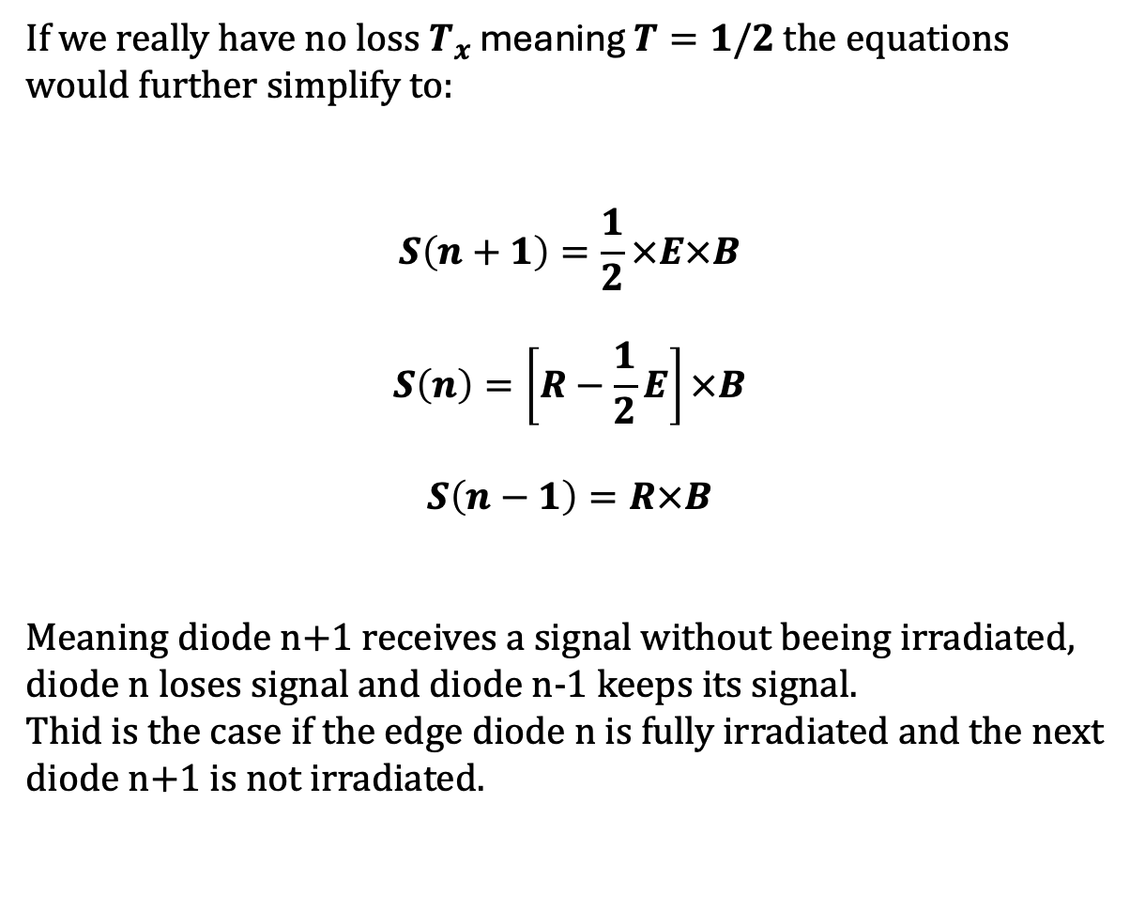
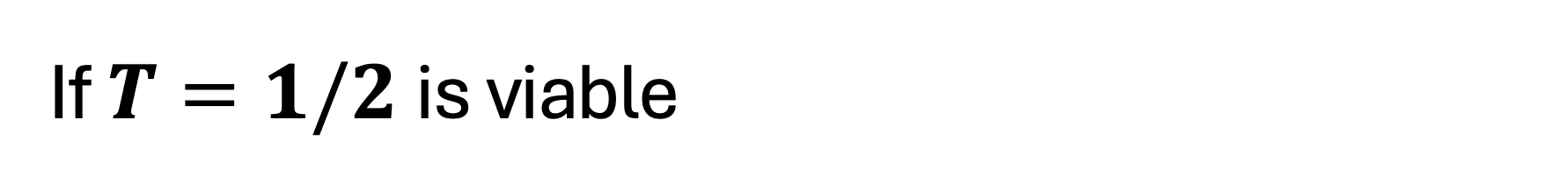
If $T=1/2$is viable
If we really have no loss $T_{x}$ meaning $T=1/2$ the equations would further simplify to:
$$S\left(n+1\right)=\frac{1}{2}×E×B$$
$$S\left(n\right)=\left[R−\frac{1}{2}E\right]×B$$
$$S\left(n−1\right)=R×B$$
Meaning diode n+1 receives a signal without beeing irradiated, diode n loses signal and diode n-1 keeps its signal.
Thid is the case if the edge diode n is fully irradiated and the next diode n+1 is not irradiated.
Diode n+1
Diode n
Diode n-1

Slide 17

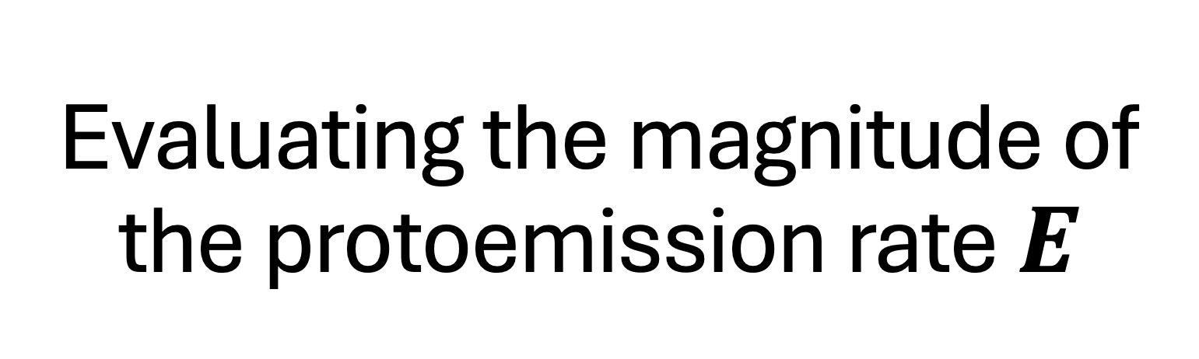
Evaluating the magnitude of the protoemission rate $E$
Since the rates $E$ and $R$ are global diode array constants under the previously defined assumptions, we can compare both to see the influence on the signal.

Slide 18
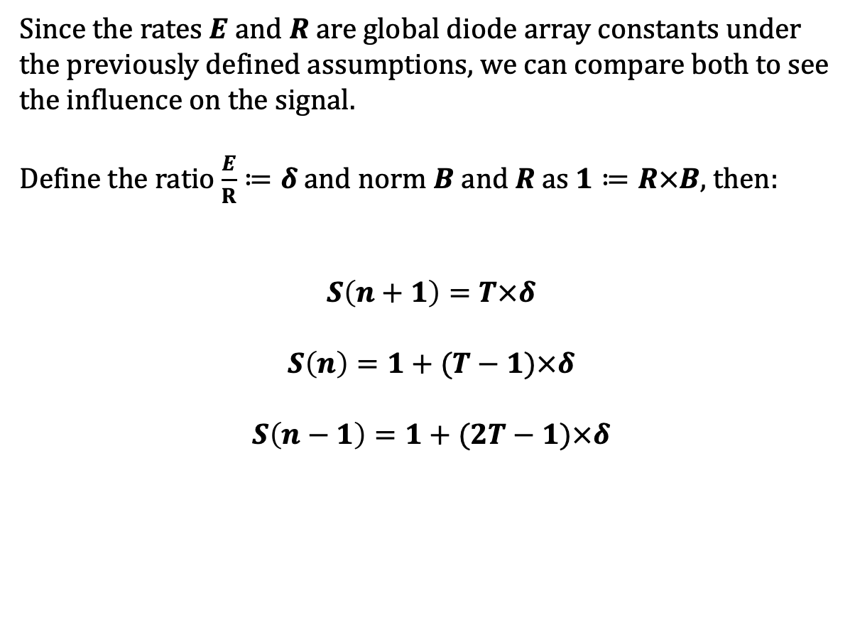
Starting with uniform beam equations
Since the rates $E$ and $R$ are global diode array constants under the previously defined assumptions, we can compare both to see the influence on the signal.
Define the ratio $\frac{E}{R}≔δ$and norm $B$ a$nd R$ as $1≔R×B$, then:
$$S\left(n+1\right)=T×δ$$
$$S\left(n\right)=1+(T−1)×δ$$
$$S\left(n−1\right)=1+(2T−1)×δ$$
Diode n+1
Diode n
Diode n-1

Slide 19
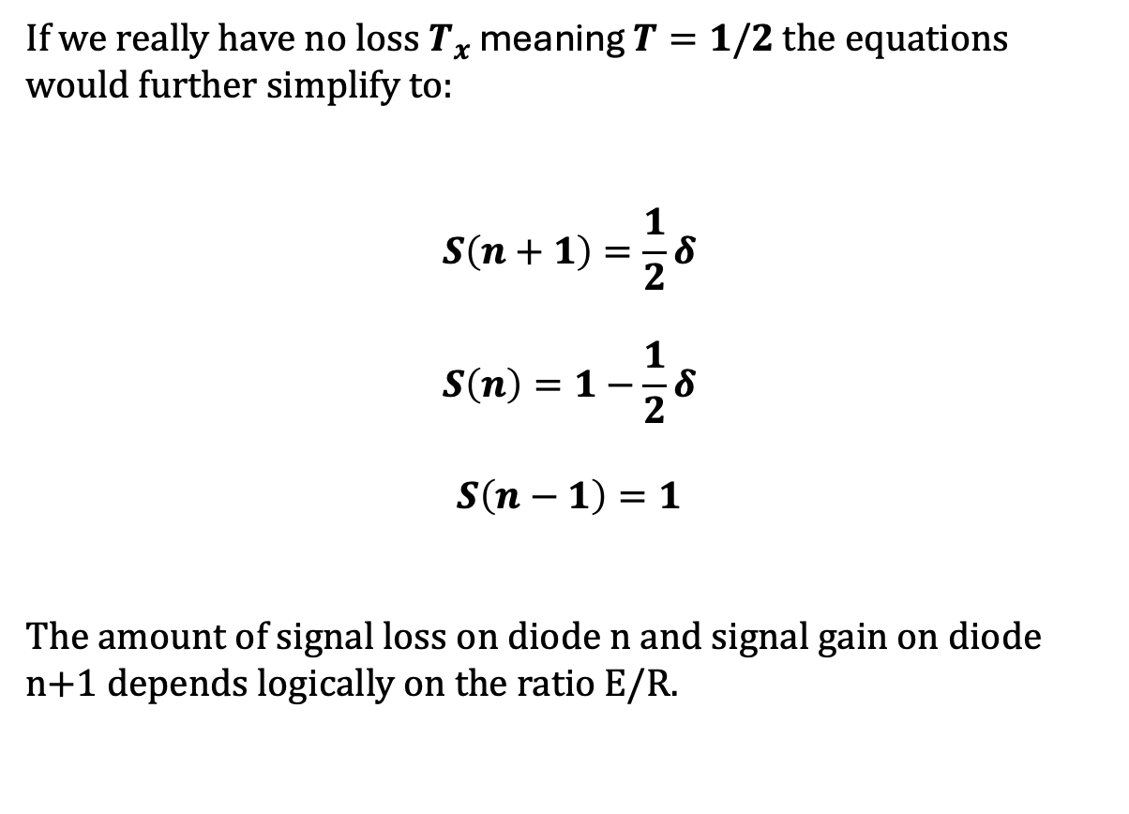
If $T=1/2$is viable
If we really have no loss $T_{x}$ meaning $T=1/2$ the equations would further simplify to:
$$S\left(n+1\right)=\frac{1}{2}δ$$
$$S\left(n\right)=1−\frac{1}{2}δ$$
$$S\left(n−1\right)=1$$
The amount of signal loss on diode n and signal gain on diode n+1 depends logically on the ratio E/R.
Diode n+1
Diode n
Diode n-1

Slide 21
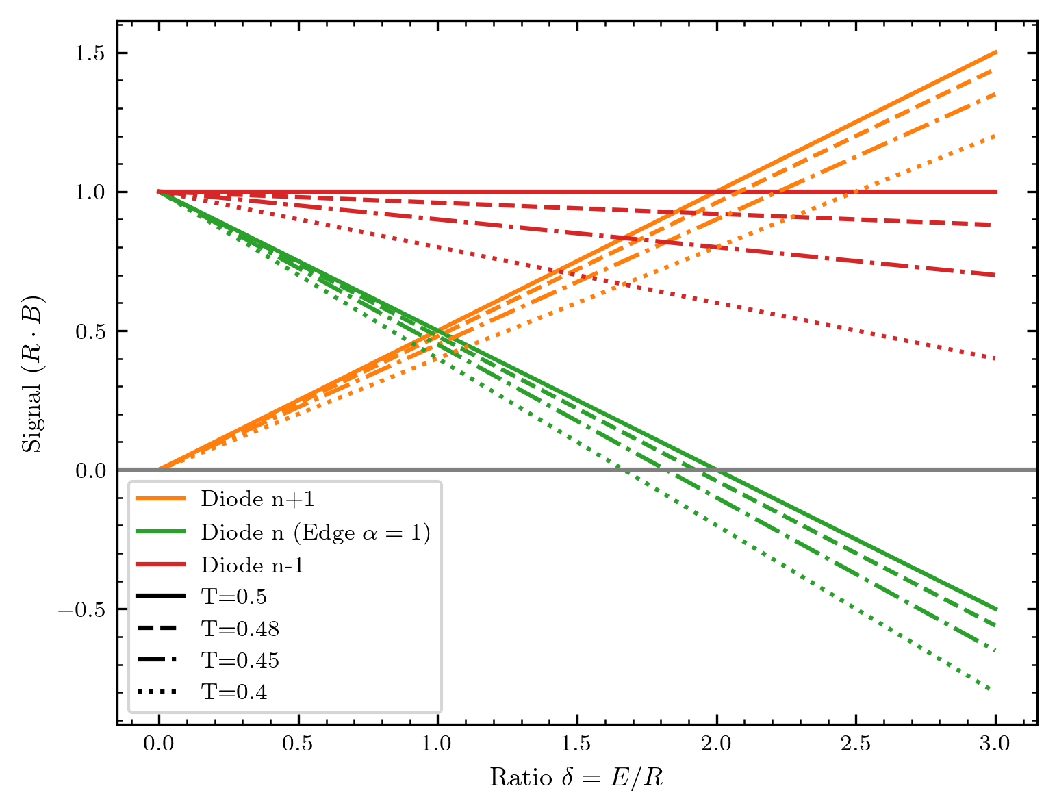

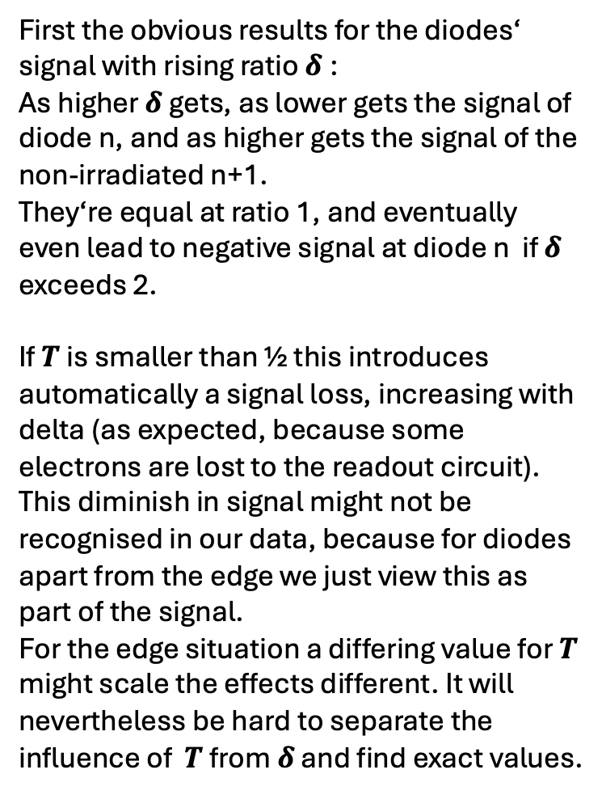
Some thoughts on $T≤$1/2
First the obvious results for the diodes‘ signal with rising ratio $δ$:
As higher $δ$ gets, as lower gets the signal of diode n, and as higher gets the signal of the non-irradiated n+1.
They‘re equal at ratio 1, and eventually even lead to negative signal at diode n if $δ$ exceeds 2.
If $T$ is smaller than ½ this introduces automatically a signal loss, increasing with delta (as expected, because some electrons are lost to the readout circuit).
This diminish in signal might not be recognised in our data, because for diodes apart from the edge we just view this as part of the signal.
For the edge situation a differing value for $T$ might scale the effects different. It will nevertheless be hard to separate the influence of $T$ from $δ$ and find exact values.

Slide 22
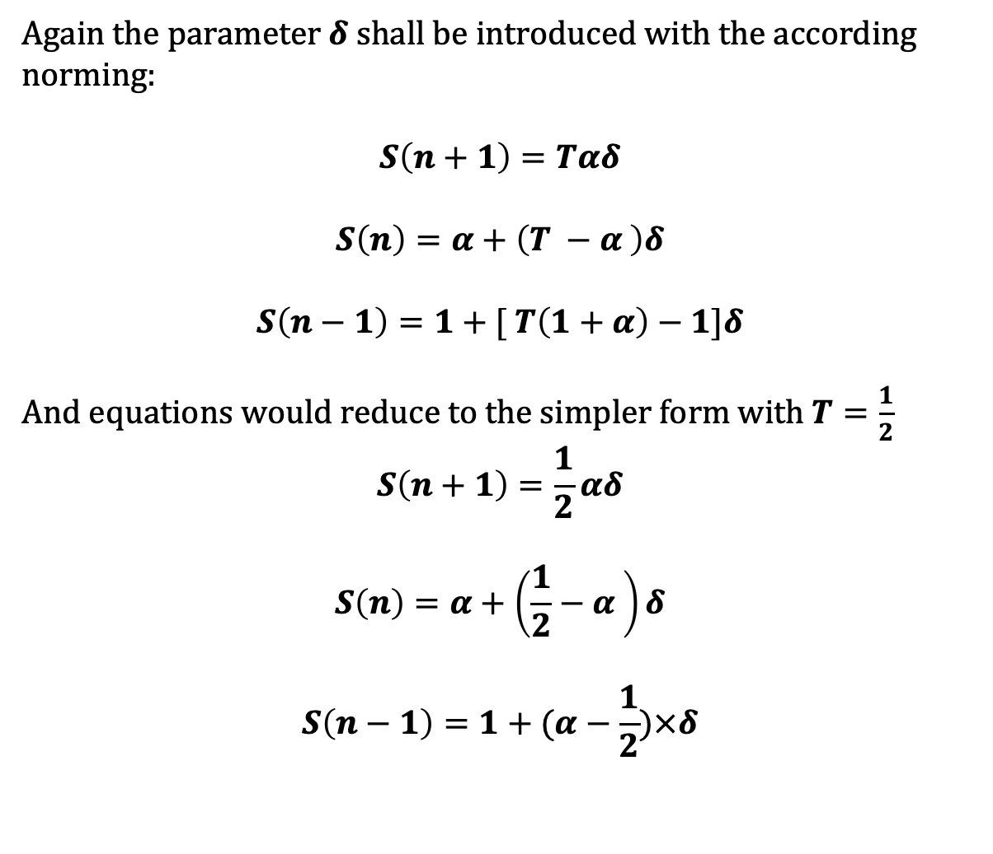

We add the complexity of edge covering $α$
Again the parameter $δ$ shall be introduced with the according norming:
$$S\left(n+1\right)=Tαδ$$
$$S\left(n\right)=α+\left(T −α \right)δ$$
$$S\left(n−1\right)=1+[ T\left(1+α\right)−1]δ$$
And equations would reduce to the simpler form with $T=\frac{1}{2}$
$$S\left(n+1\right)=\frac{1}{2}αδ$$
$$S\left(n\right)=α+\left(\frac{1}{2}−α \right)δ$$
$$S\left(n−1\right)=1+(α−\frac{1}{2})×δ$$
Diode n+1
Diode n
Diode n-1

Slide 23
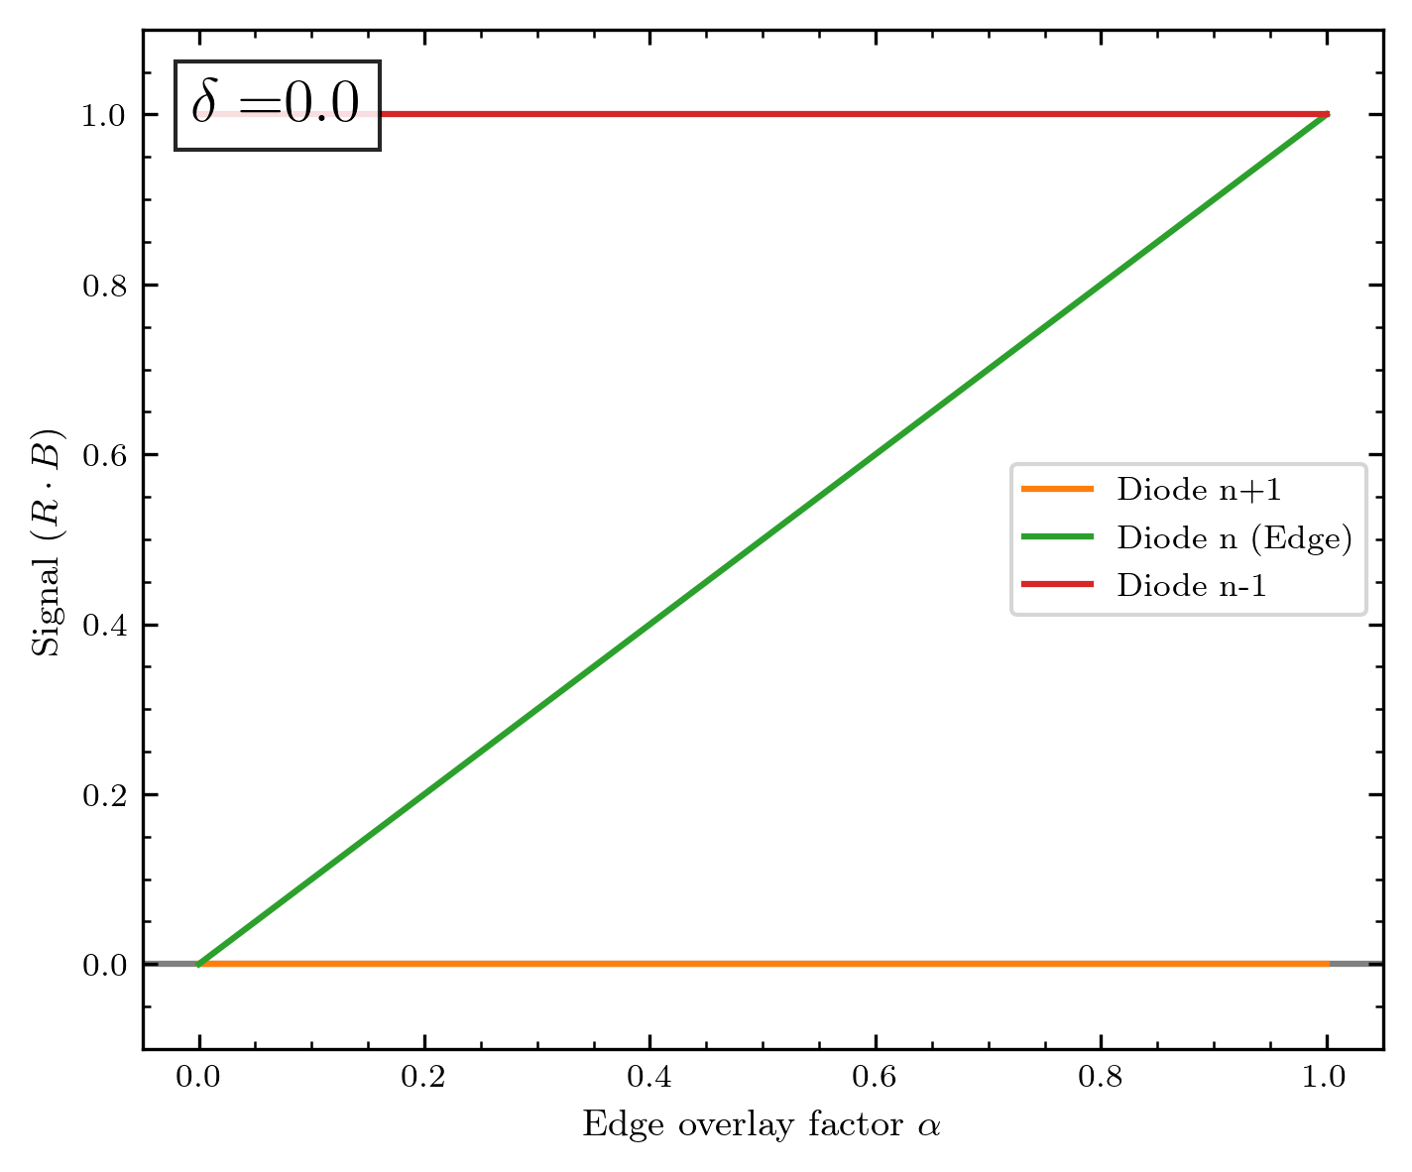
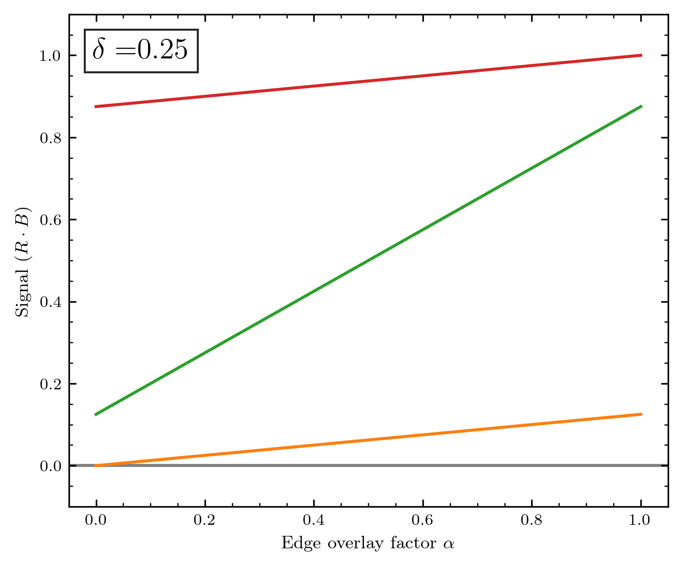
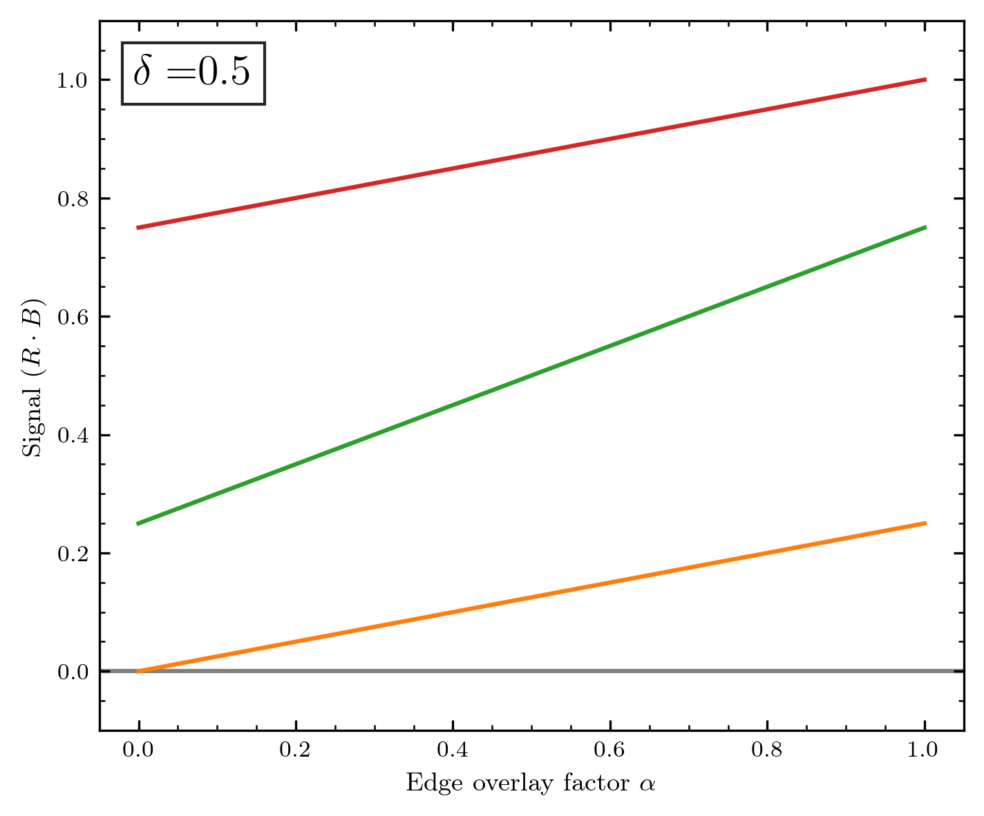
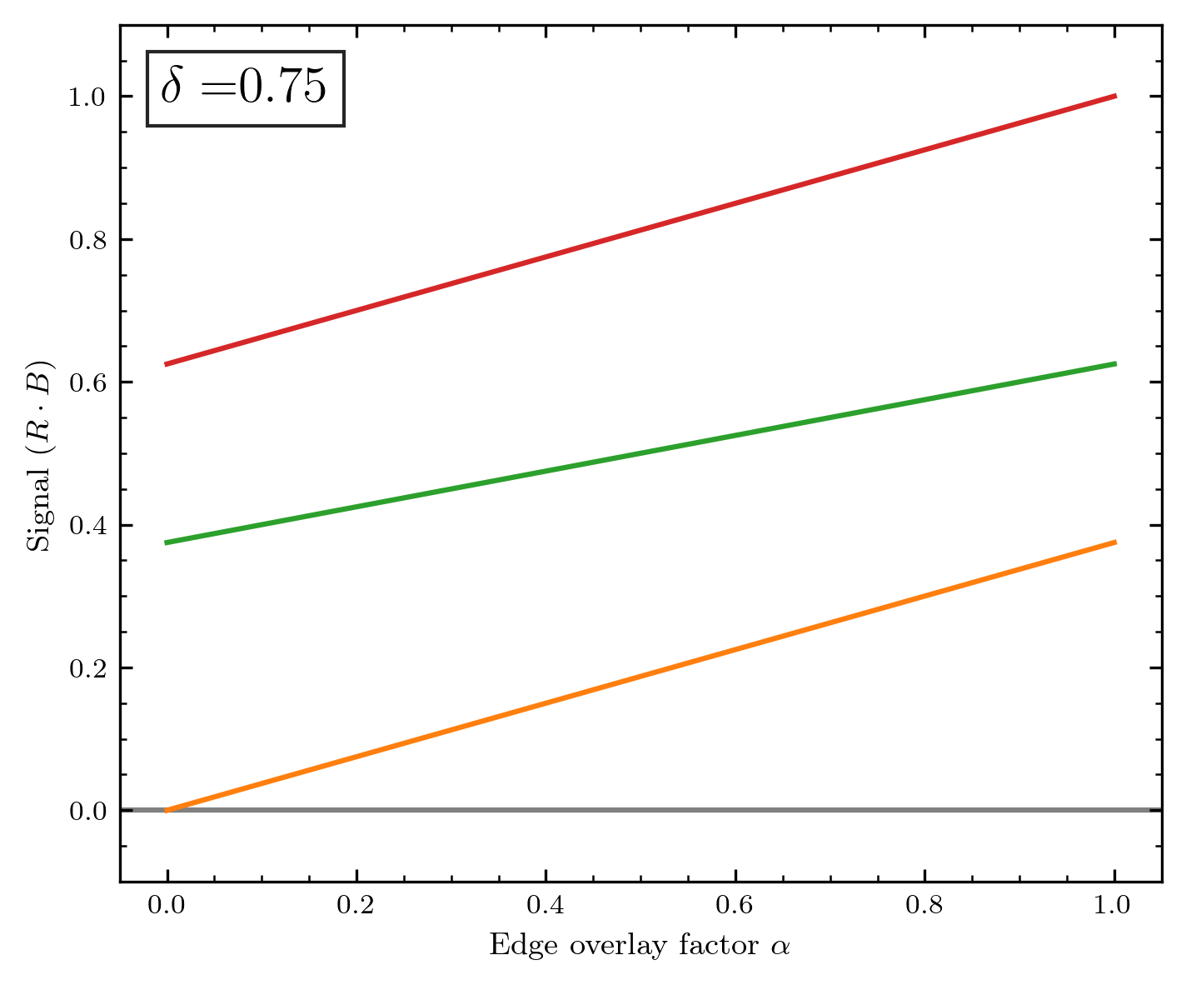
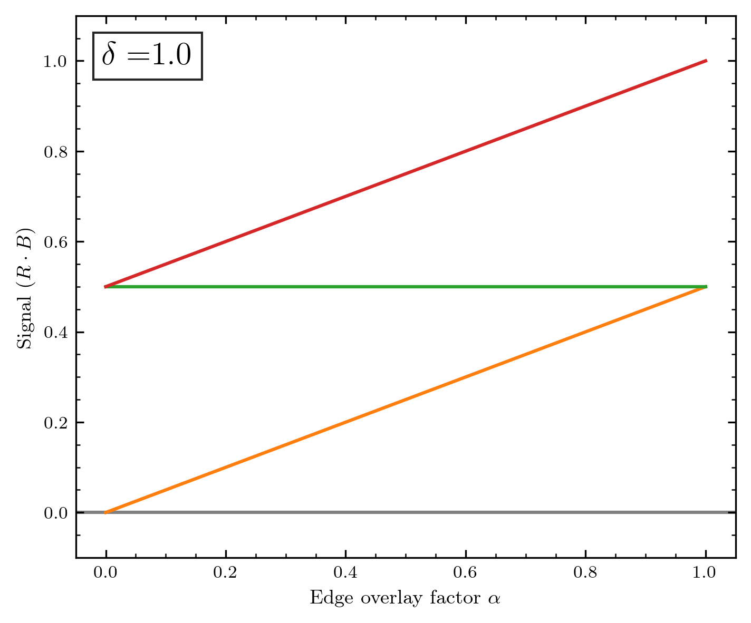
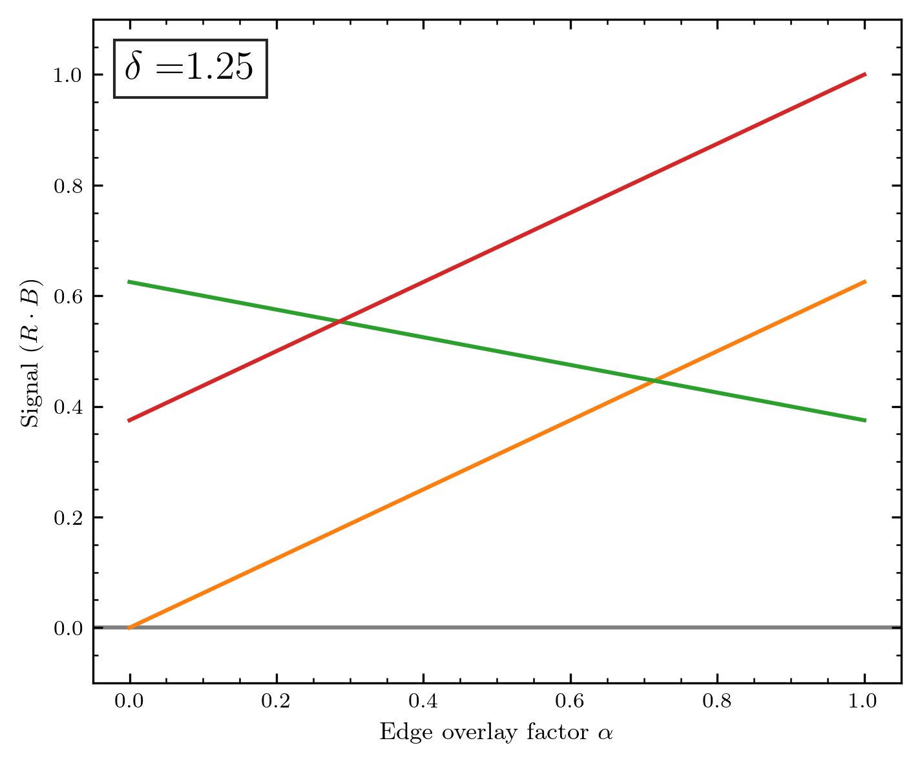

Slide 24
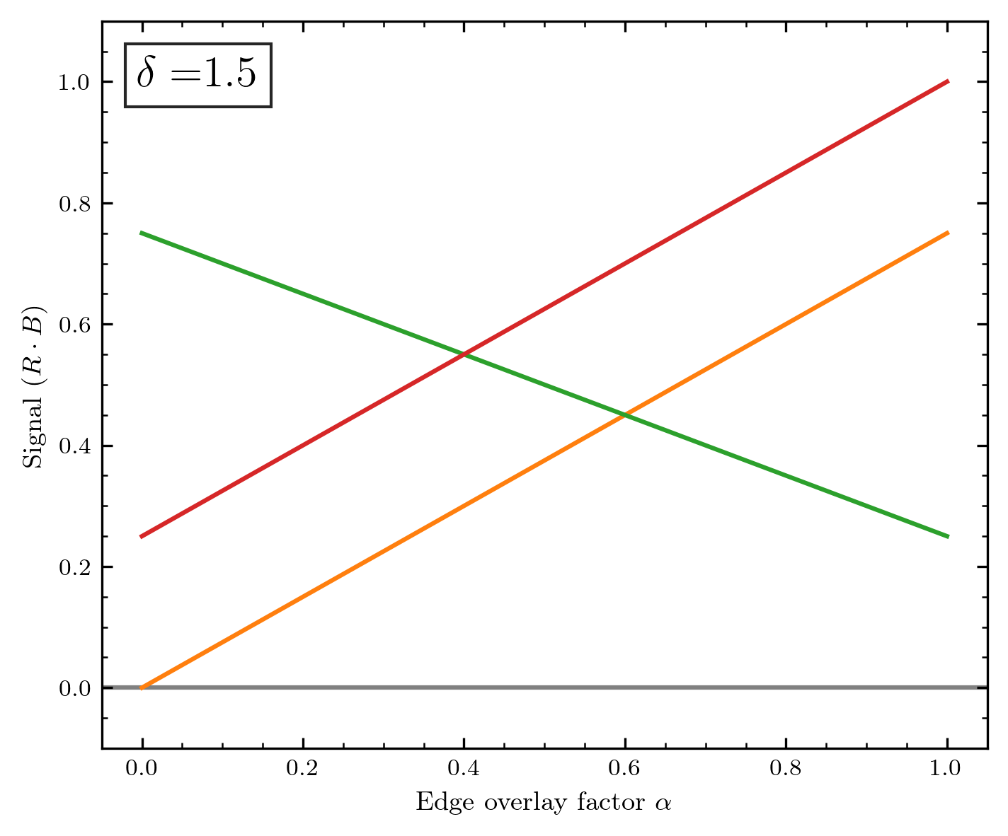
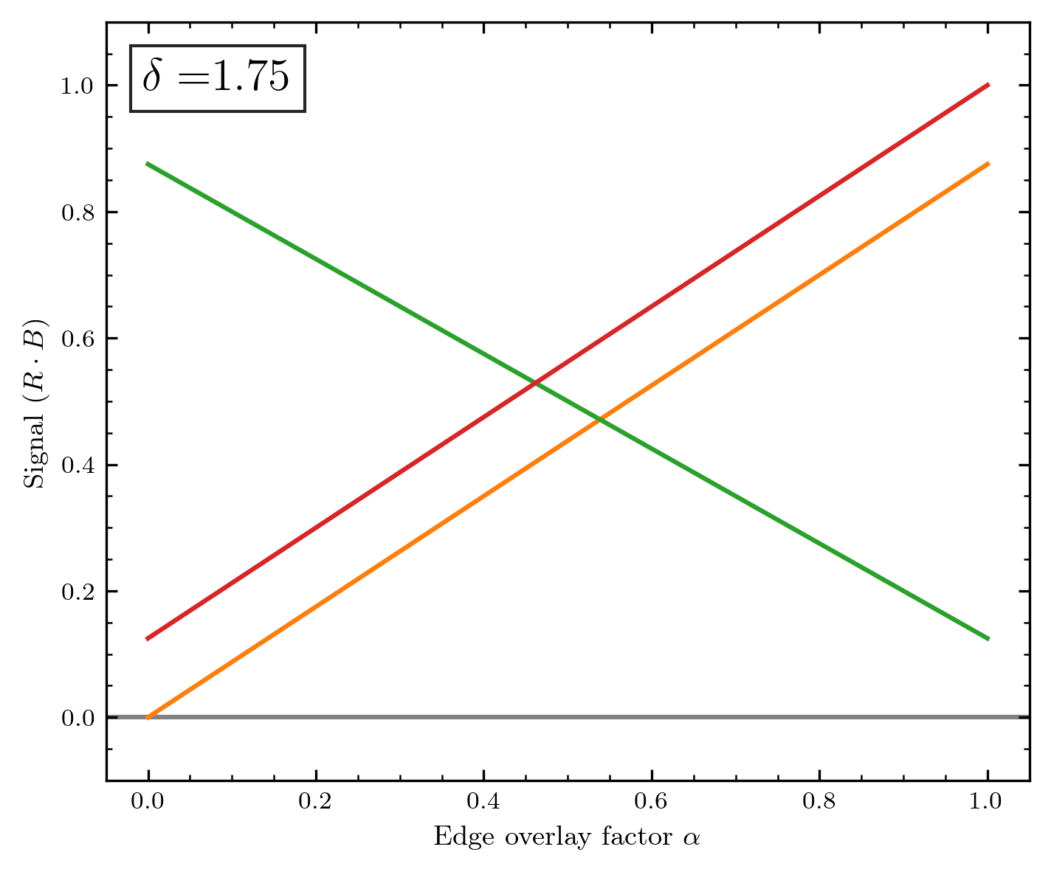
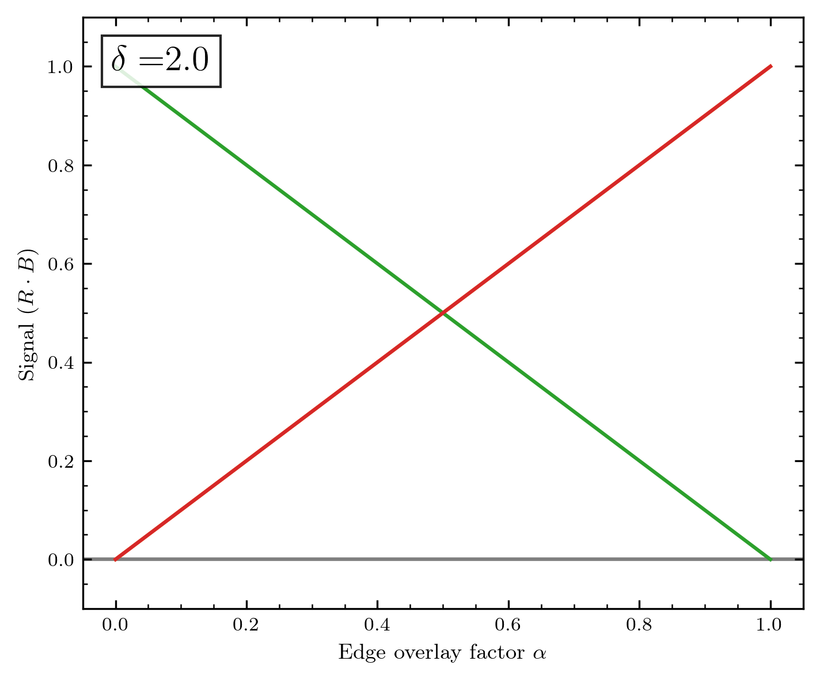
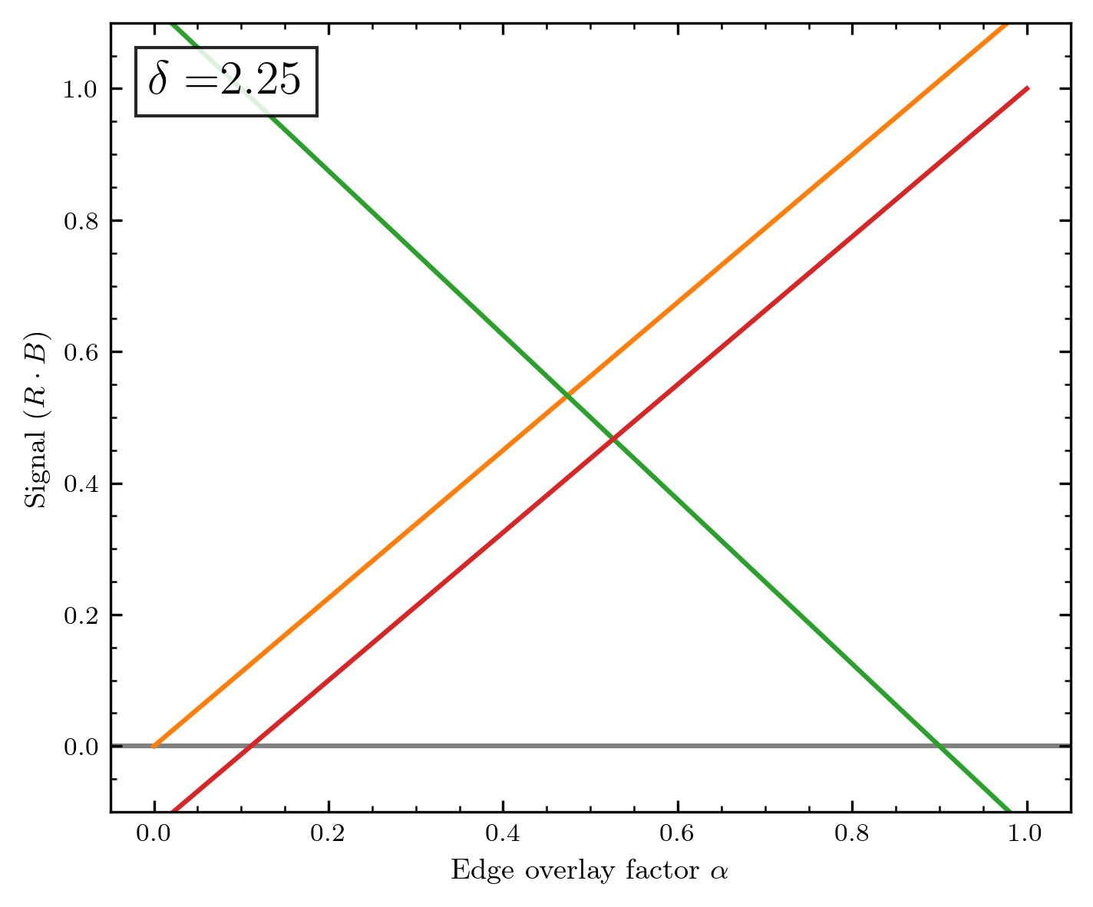
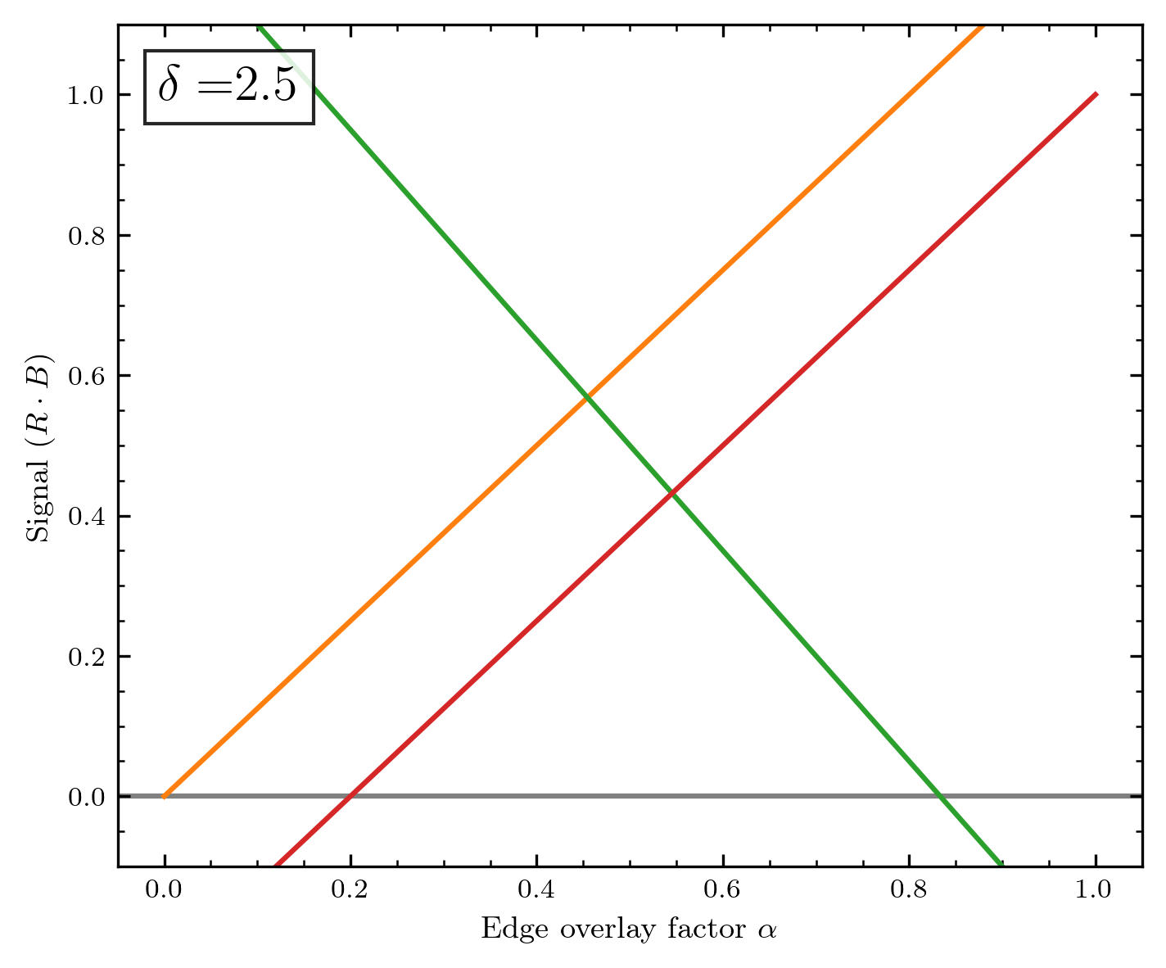
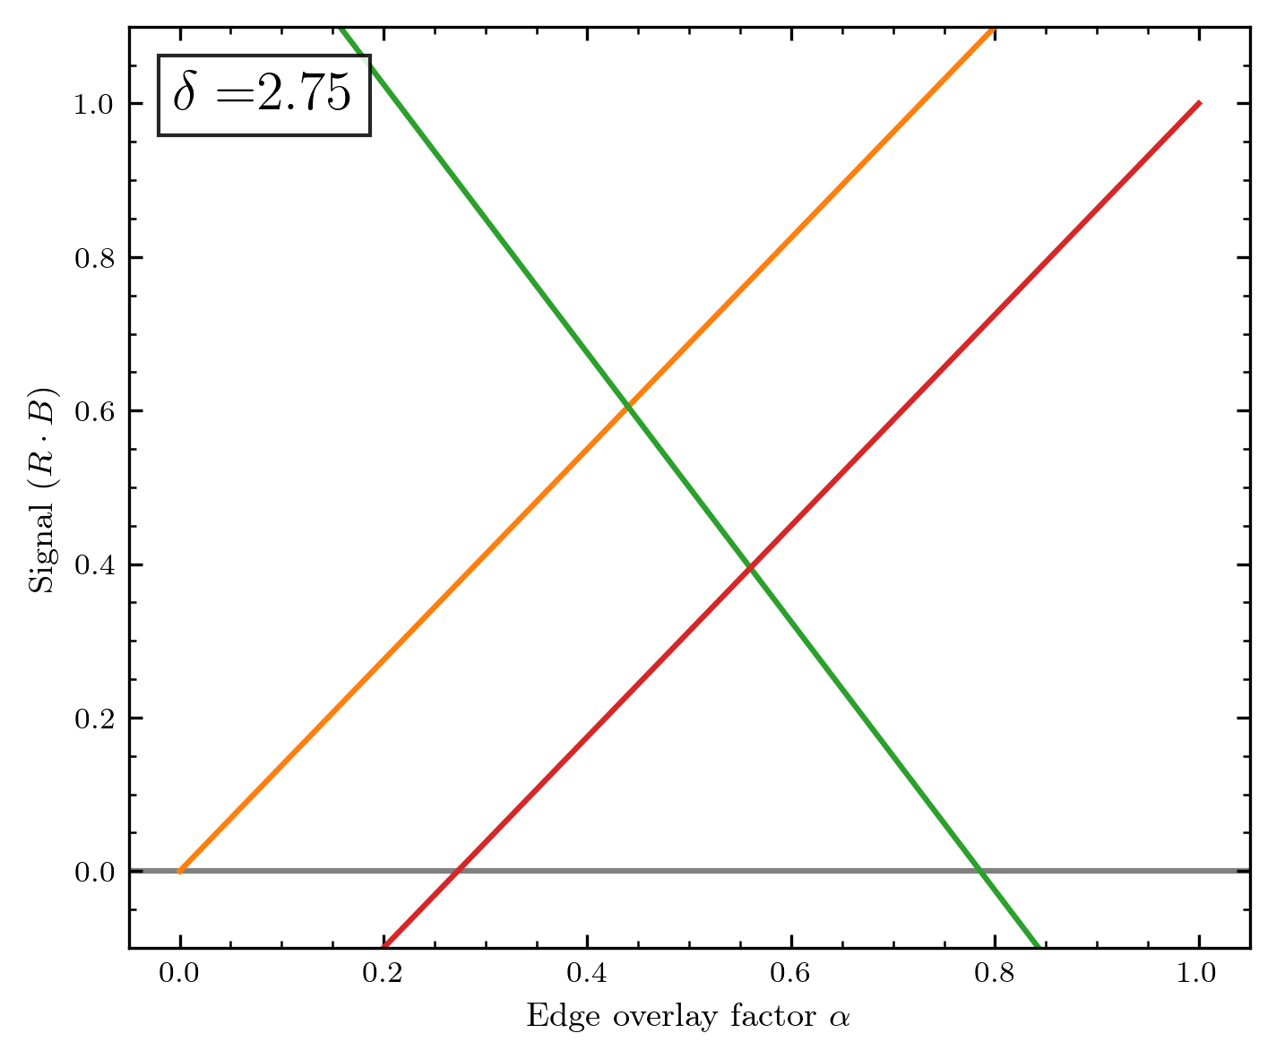

Slide 25
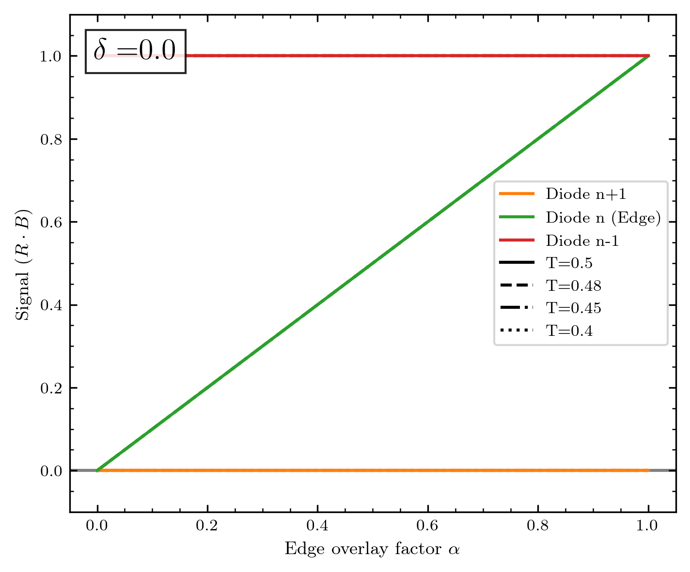
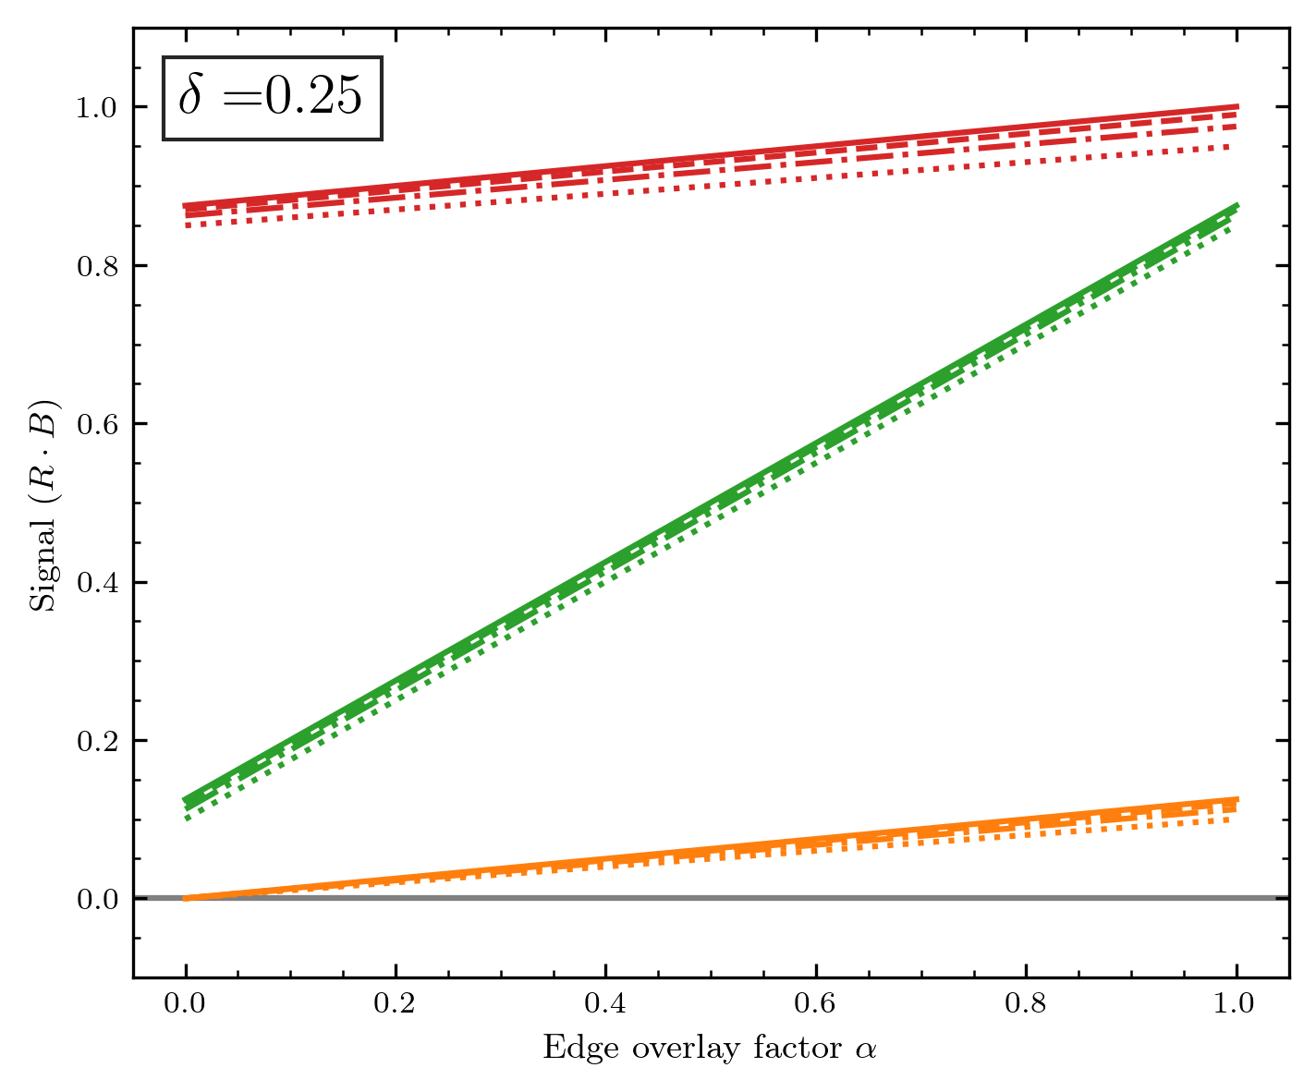
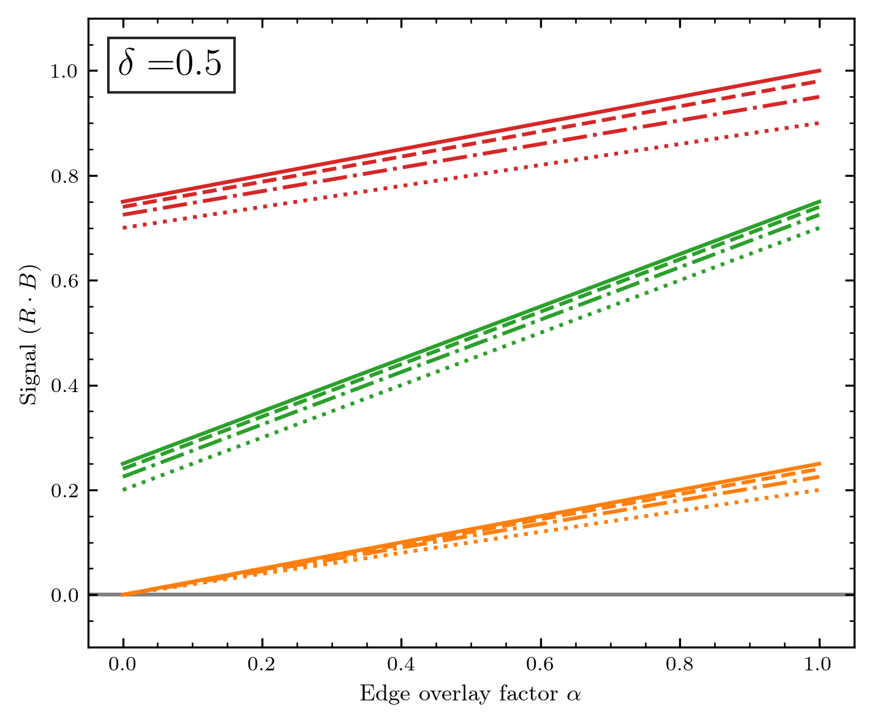
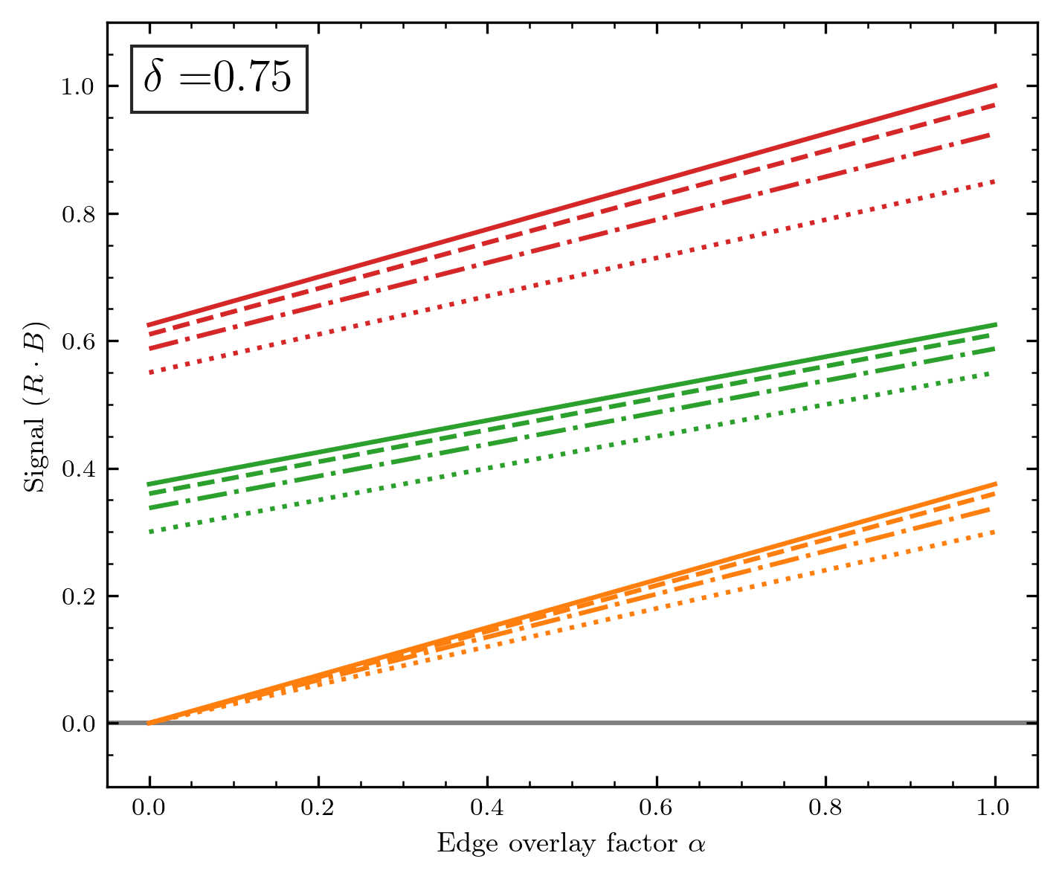
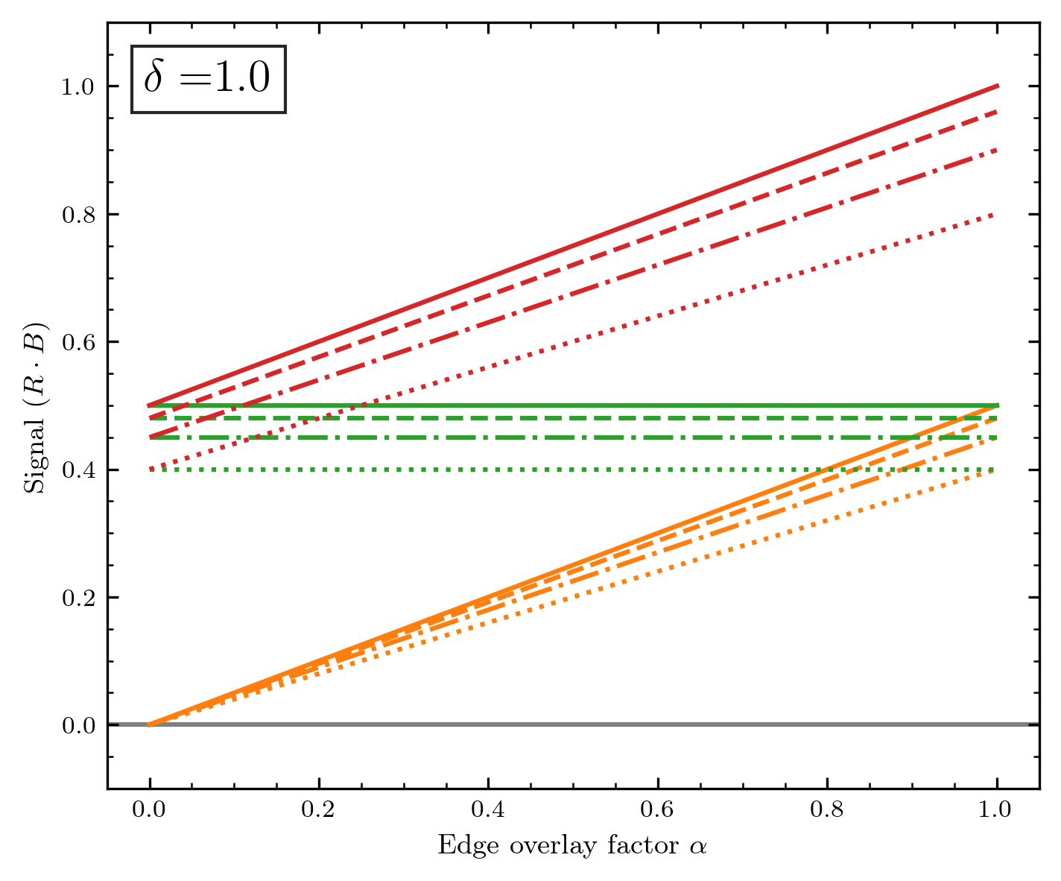
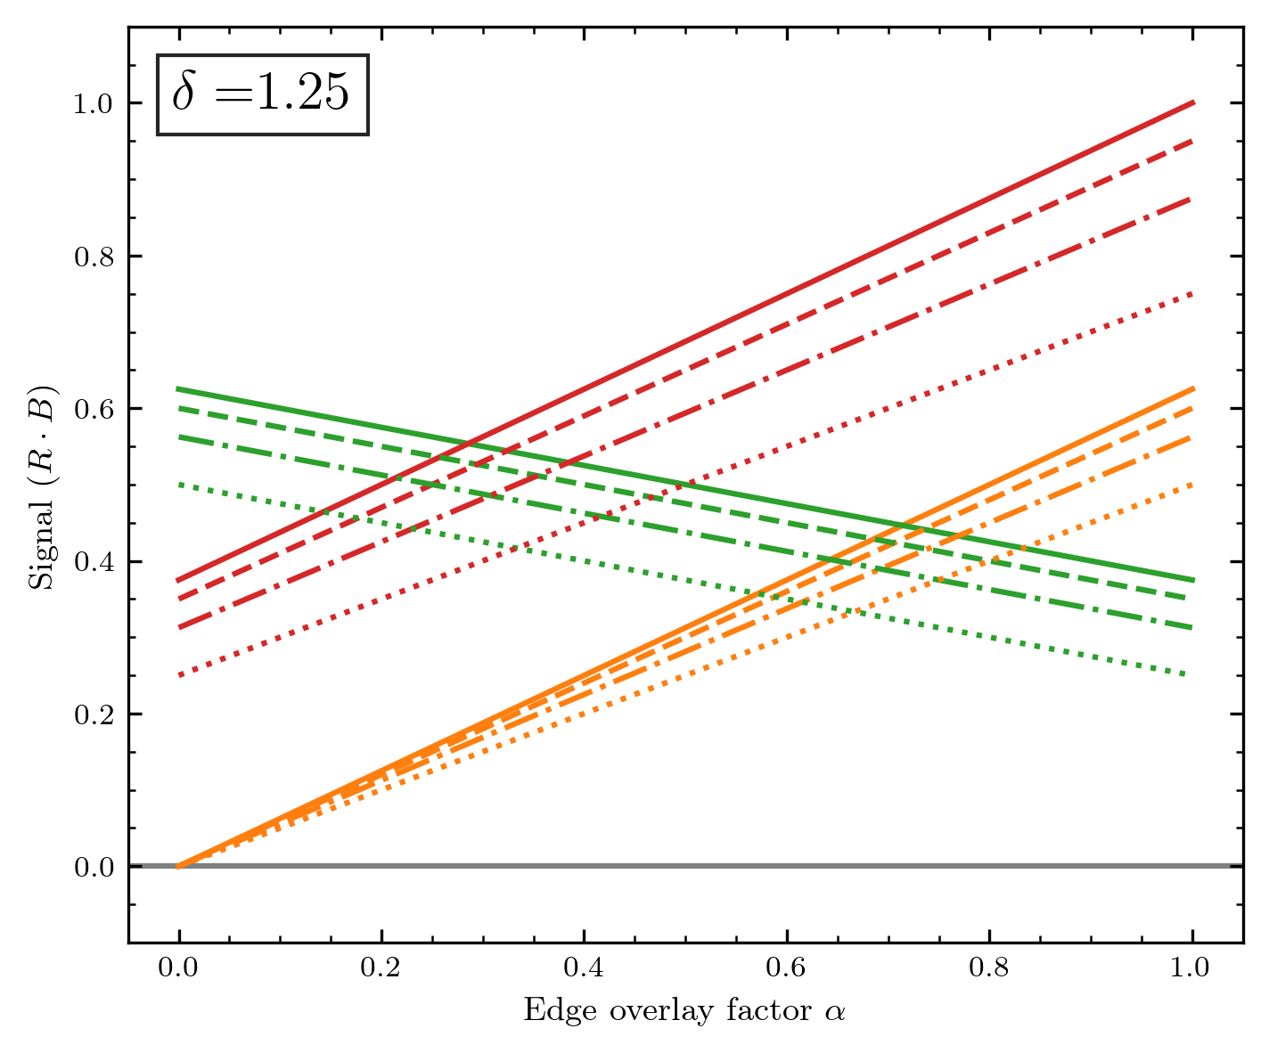

Slide 26
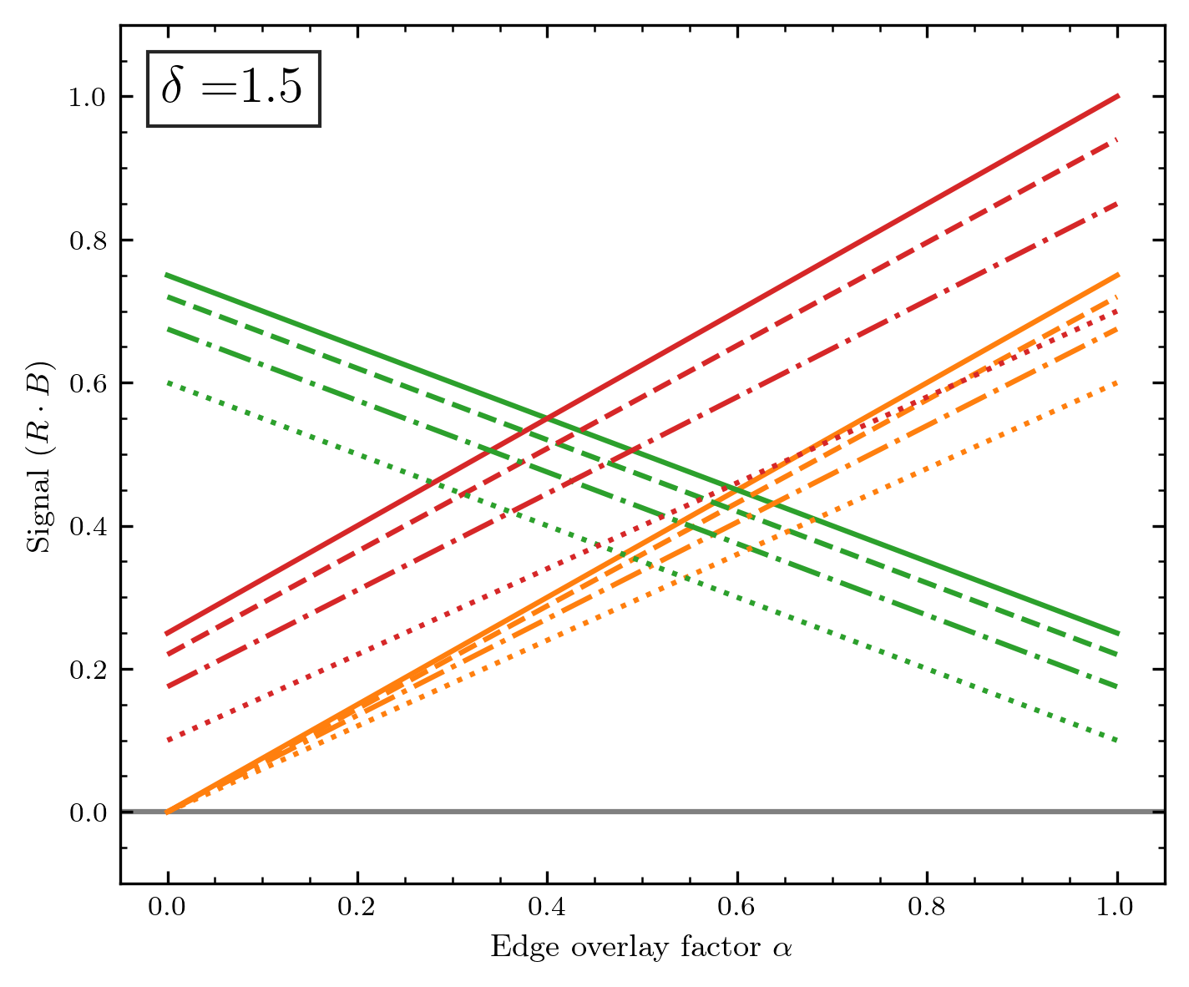
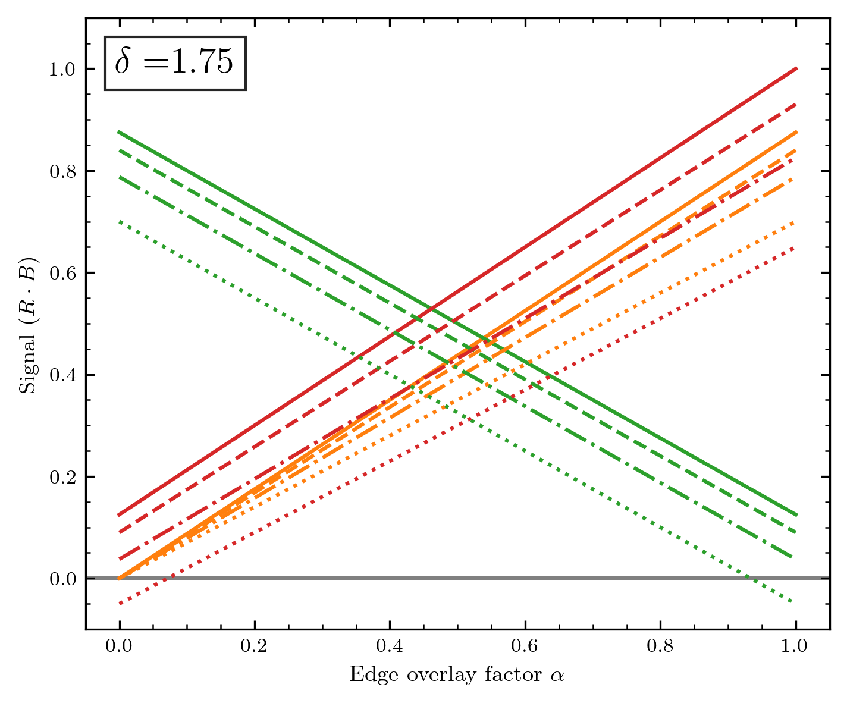
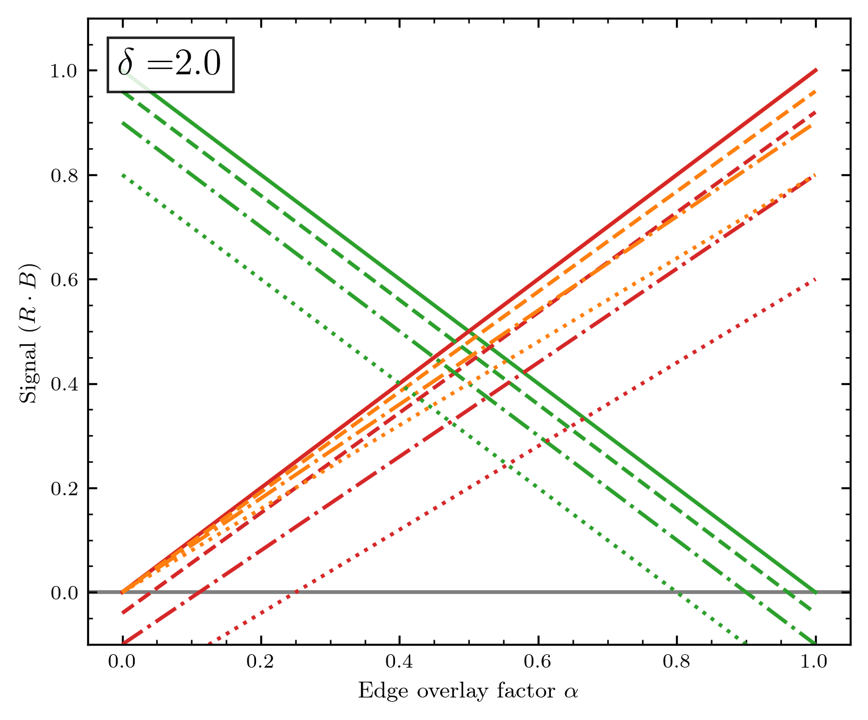
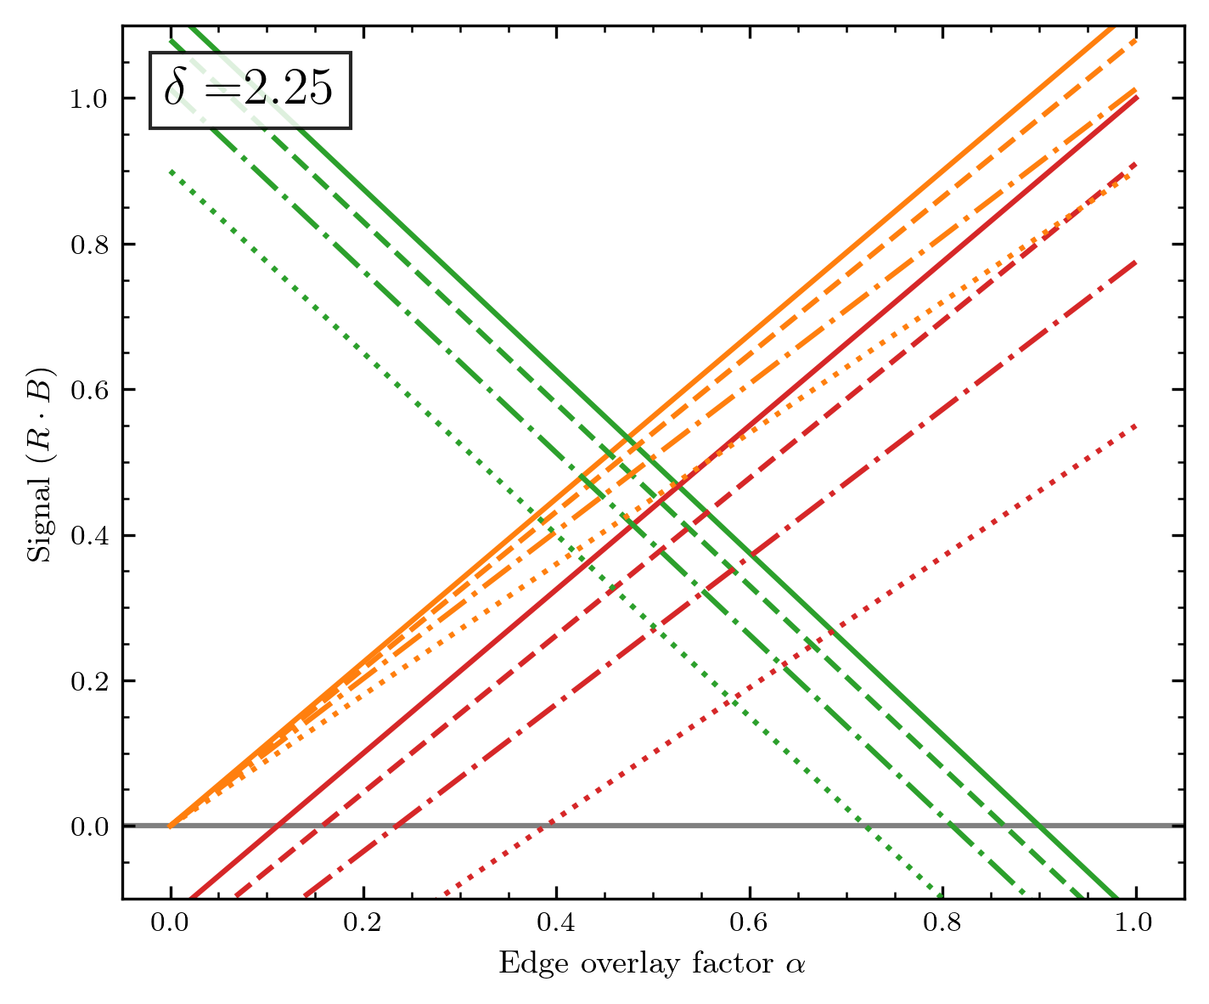
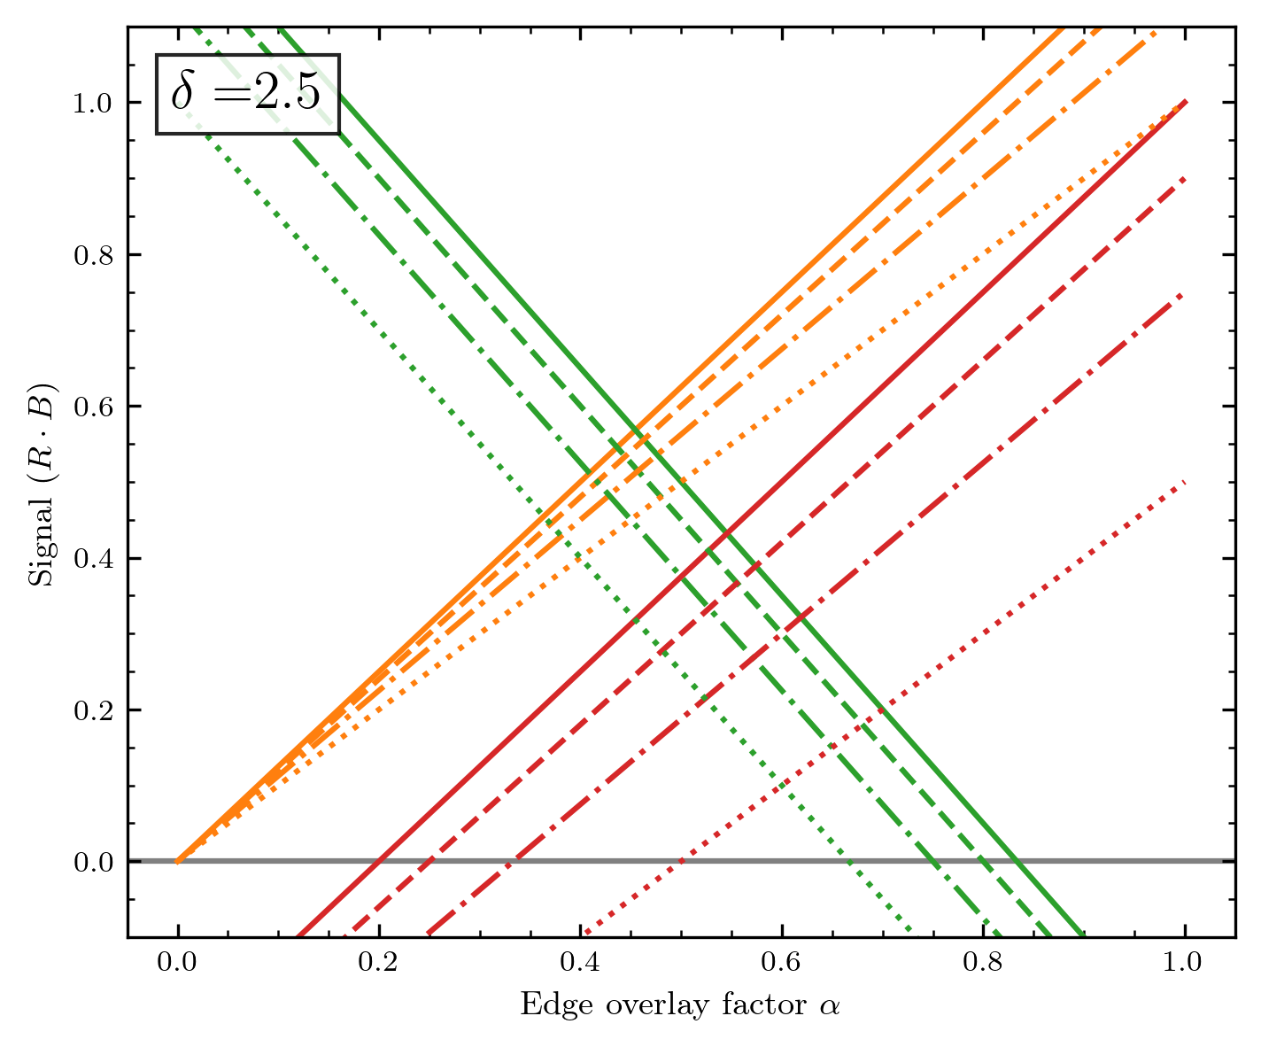
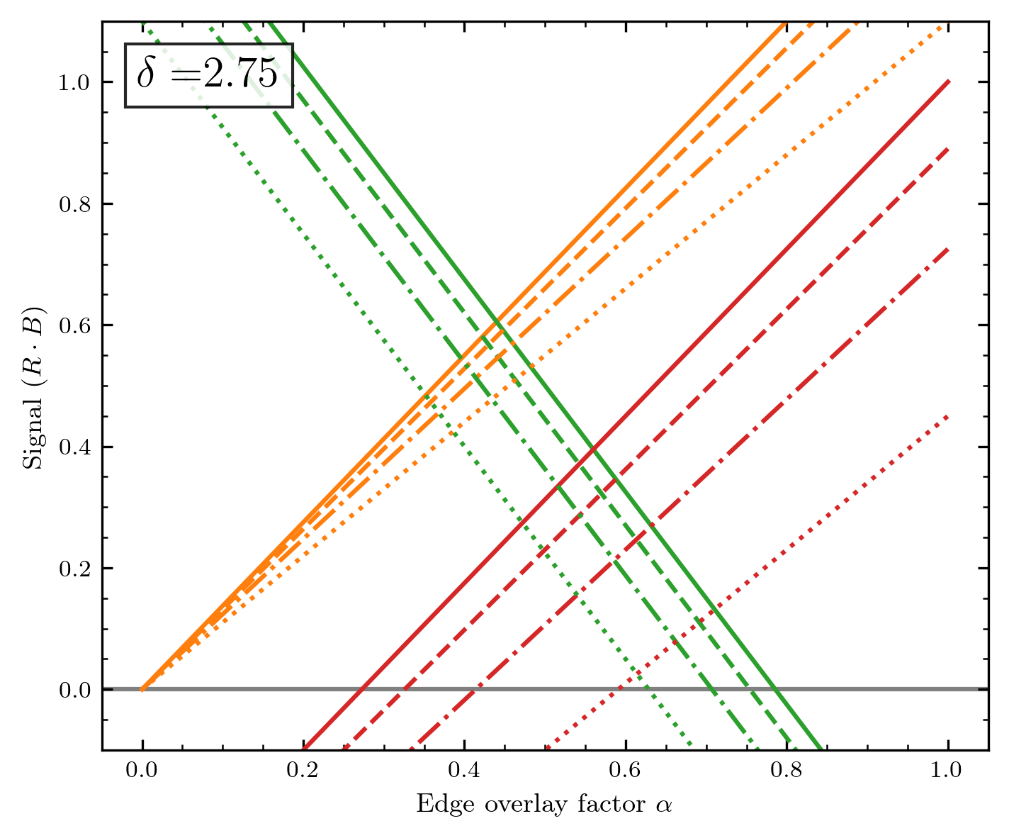

Slide 27
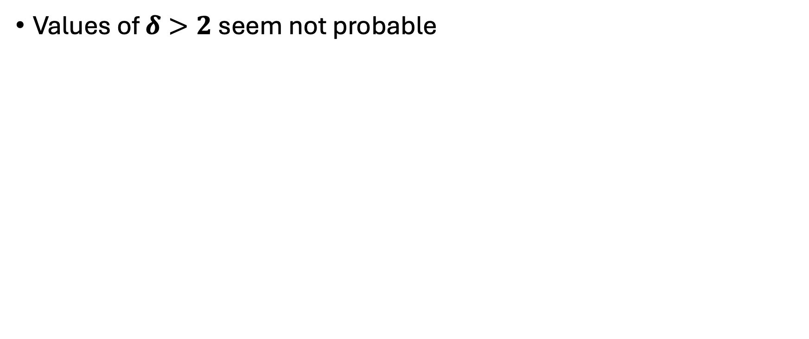
Conclusion
Values of $δ>2$ seem not probable

Slide 28
Designing a correction algorithm
Case: Uniform beam

Slide 29
At first: The correction needs to be applied at each diode array position
This means that for each measurement of the diode array, the correction has to be evaluated – or in other words, we need to localize the edges, which will change for each array position.
I do not want the correction to be fully hand-adjusted, even though total automatisation will also be nearly impossible.
What we at least need: Some info about the shape that was mapped, otherwise the correction makes no sense.
(Imagine a chessboard-like structure mapped with each field having the size of one diode. The algorithm I develop will probably not treat this correct)

Slide 30
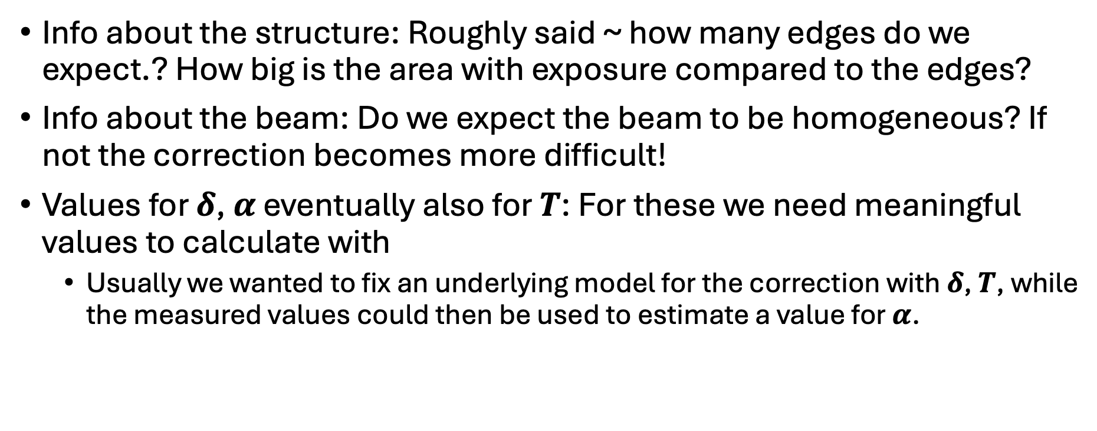
User input for the correction
Info about the structure: Roughly said ~ how many edges do we expect.? How big is the area with exposure compared to the edges?
Info about the beam: Do we expect the beam to be homogeneous? If not the correction becomes more difficult!
Values for $δ$, $α$ eventually also for $T$: For these we need meaningful values to calculate with
Usually we wanted to fix an underlying model for the correction with $δ$, $T$, while the measured values could then be used to estimate a value for $α$.

Slide 31
Rough sketch of the algorithm
Detect edges for the diode array measurement, where a correction needs to be applied.
For all edges: Check if there could be conflict if edges are too close together. (If conflict: …? Maybe more complicated model?)
For all edges without conflict:
Compare the signal of the diodes around the edge
Correct corresponding to model n+1 to 0, n to S(n)+S(n+1) and S(n-1) to full signal
Maybe useful during parameter search: Compare model parameters between each row of map

Slide 32
Detect the edge
For uniform beam: Find a global threshold between signal and no signal
We already used the optimal solution: Otsu‘s method! (Signal and no signal will still be distributed somehow.)
With threshold: Find all changes from no signal to signal (and vice versa)
To verify the edge characteristic check for signature: Signal low to signal high, back to low, then to high (and vice-versa)
If edge is detected do not consider the involved diodes again in the edge search
As shown on the left sketch, one edge pattern will probably trigger three events when using the Otsu‘s threshold.
Problems could occure if the variation is too low (under the threshold) because we e.g. only irradiate a small part of the diode array)
S(n)
n

Slide 33
Limits and problems with model

Slide 34
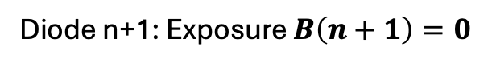
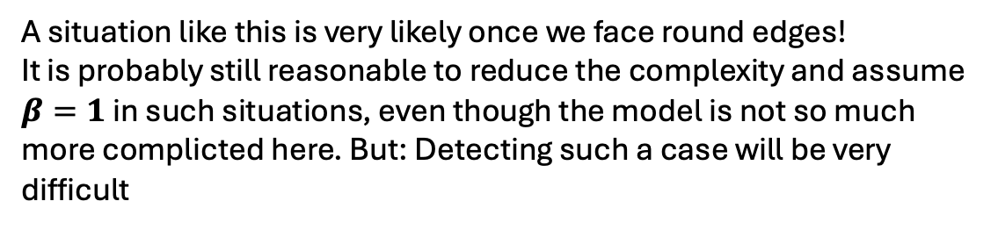
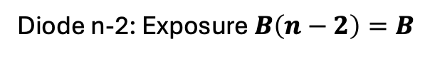


Some add to complexity
A situation like this is very likely once we face round edges!
It is probably still reasonable to reduce the complexity and assume $β=1$ in such situations, even though the model is not so much more complicted here. But: Detecting such a case will be very difficult
Diode n+1: Exposure $B\left(n+1\right)=0$
Diode n: Exposure $B\left(n\right)=α×B$
Diode n-1: Exposure $B\left(n−1\right)=β×B$
Diode n-2: Exposure $B\left(n−2\right)=B$
For consistency, I will define a name for this situation and other effects in the following.
This situation shall be denoted as “Multi-Edge“

Slide 35

Some possible problems with the model
Look at the irradiated regions where electrons are emitted.
If we now compare the distance electrons have to travel to reach the neighbour diodes, a discrepancy becomes visible.
I will denote this effect as “Induction of asymmetry“ as it lifts the symmetry and the following simplifications for the diode array.
Namely, this could impact the transfer efficiencies in our model, meaning:
$$T\left(n, n+1\right)<T\left(n, n−1\right)$$
Note that the induced asymmtetry is dependent on the amount of overlay between edge diode n and proton beam irradiation.
The less the diode is irradiated, the bigger the difference in distance is, the bigger the induced asymmetry would get.
Thus the rates $T$ would depend to the beam exposure, and problematically on the geometry of beam exposure.
Diode n+1
Diode n
Diode n-1

Slide 36

Induction of asymmetry for uniform beam
For the uniform beam we already introduced a way to handle the partial irradiation of the edge diode n as: $B\left(n\right)=α×B$
To model the induced asymmetry we could just scale the transfer effiencies with this factor $α$. At first I keep this as general as possible:
If diode n is exposed as$B\left(n\right)=α×B$, we can describe the transfer efficiencies as:
$T\left(n, n+1\right)=ζ\left(α\right) T\left(n, n−1\right)$
with $ζ\left(α\right)∈\left[0, 1\right]$ and $T\left(n, n+1\right)+ζ\left(α\right) T\left(n, n−1\right)=1 −Tx$
(I assume without loss of generality $B\left(n+1\right)=0$ and $B\left(n+1\right)=B$)
To simplify it seems reasonable to assume the linear depency:
$$ζ\left(α\right)=ζ×α ≔ζ^{∗}$$
While I assume the assumption $ζ\left(α\right)=α$ as not necessarily viable.
Diode n+1
Diode n
Diode n-1

Slide 37

Induction of asymmetry for uniform beam
In our model this would change the general signal for a diode n to:
$$S\left(n\right)=\left(R−E\right) ×α_{n}×B$$
$$+E×ζ×α_{n+1}×T×α_{n+1}×B$$
$$+E×ζ×α_{n−1}×T×α_{n−1}×B$$
= $[\left(R−E\right) ×α_{n}+ζ×(α_{n+1}^{2}+α_{n−1}^{2})×E× T]×B$
If we assume diode n to be the only edge diode (WLOG: $α_{n}=α$, $α_{n−1}=1,α_{n+1}=0$):
$$S\left(n+1\right)=[ζ×α^{2}×E× T]×B$$
$$S\left(n\right)=[\left(R−E\right) ×α+ζ×E× T]×B$$
$$S\left(n−1\right)=[\left(R−E\right)+ζ×(1+α^{2})×E× T]×B$$

Slide 38



Induction of asymmetry for uniform beam
I formulate the three equations similar to above for evaluating how the ratio $\frac{E}{R}≔δ$ impacts the effects
$$S\left(n+1\right)=ζ{Tα}^{2}δ$$
$$S\left(n\right)=α+(ζ T−α)δ$$
$$S\left(n−1\right)=1+[ζT\left(1+α^{2}\right)−1]δ$$
This induced asymmetry induces mainly a dependency on $α^{2}$ meaning it would dampen the impact for smaller overlays with the irradiation edge.

